Slide 1
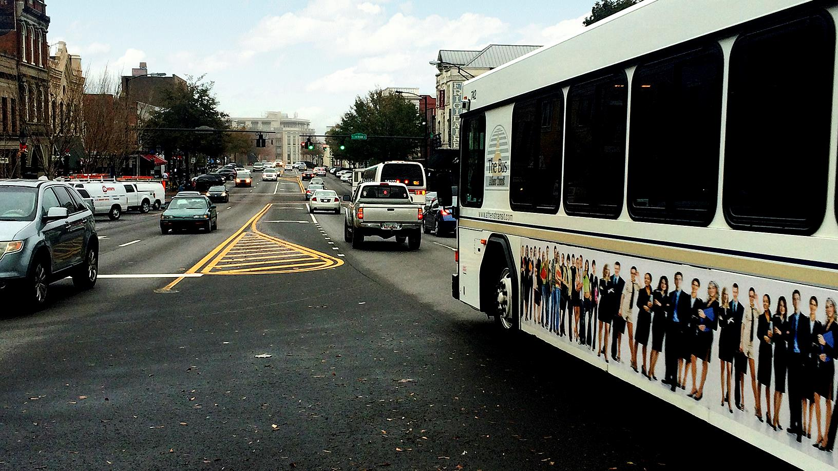

Transit feasibility study
Recommendations and Service options
June 14, 2016

Slide 2
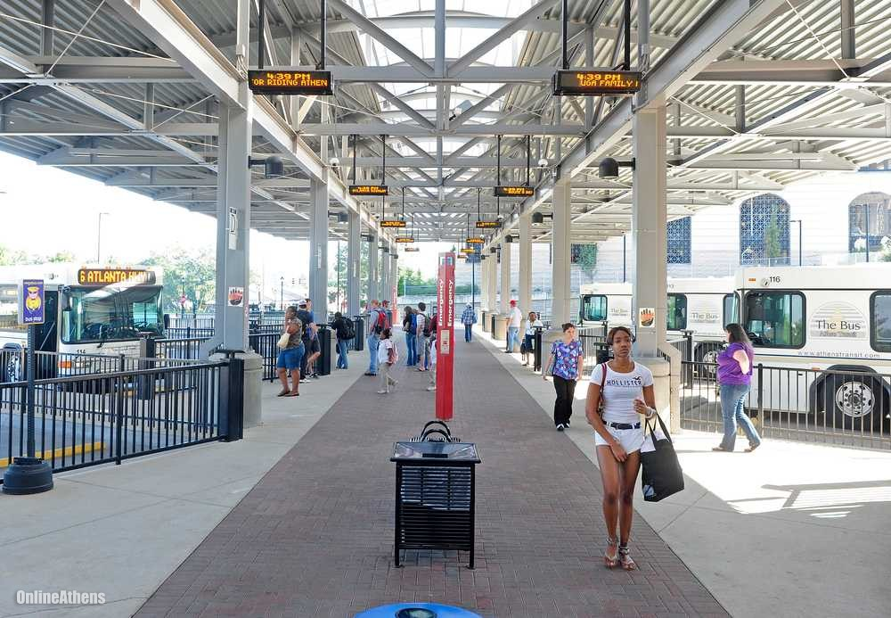
Study Purpose
Help Transit Decision Makers:
  Determine Ways to Improve Multimodal Programs
  Identify Near-term Funding Opportunities
  Identify Multimodal Projects to Increase Transit Accessibility
  Identify Transit Service Needs
  Evaluate Long Term System Operational Improvements:
    Expansion of Services, or
    Elimination and/or Consolidation of Redundant Infrastructure/services
  Identify Long-term Operational and Capital Funding Options

Slide 3
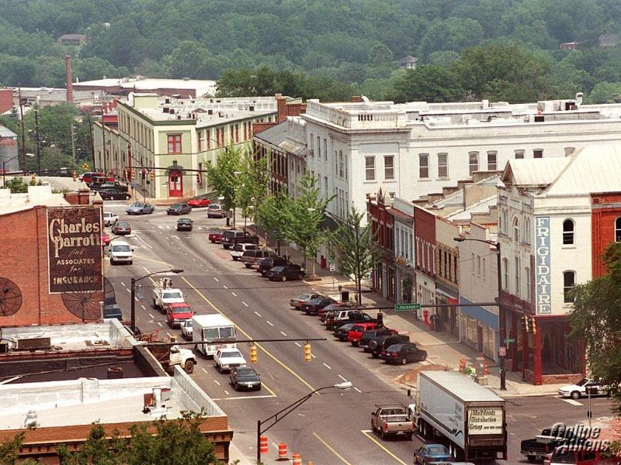
Goals and Objectives
Ensure Demand is Served
Provide Multi-modal Options
Implement System Efficiencies
Be Fiscally Prudent
Leverage Local Funding
Establish Long Term Funding Source(s)

Slide 4
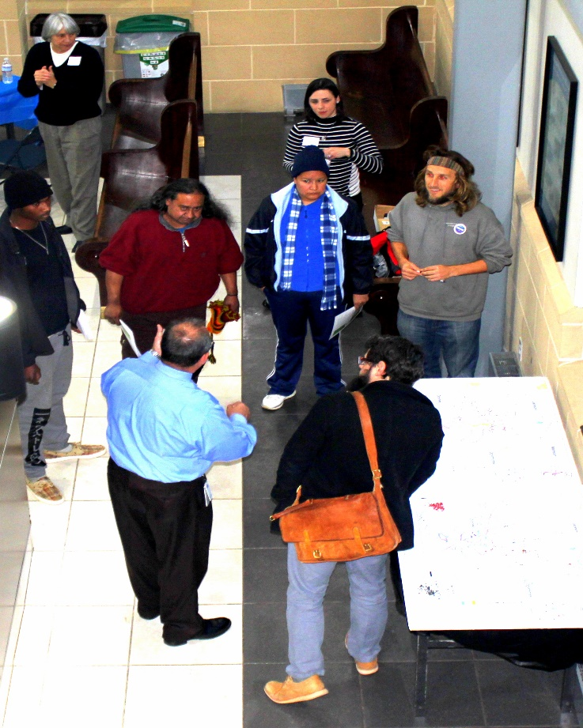
Public Participation Overview
Goals:
  Provide information
  Gather information: current travel behaviors, needs, issues, and opportunities
Outreach Approach
  Two rounds of public meetings
    February 9th and March 1st 1:00 PM – 6:30 PM Multimodal Transportation Center
  Public Survey
    Available online and paper copy
  Interactive Origin and Destination Exercises
  Separate Ridership Survey conducted on-board buses.
  Significant Focus on Advertising Participation Opportunities

Slide 5
Public Survey Overview
Survey Respondents Demographics
Current Transit Riders
Tell us about your typical transit trip.
What improvements would make transit better for you?
Non-Transit Riders
Tell us about how you travel.
What would make you more likely to try transit?
How important are the following improvements? Classify each as extremely important to not important at all.
Answer Options | Extremely Important | Very Important | Moderately Important | Slightly Important | Not at all Important
Service to new areas | 92 | 40 | 39 | 11 | 13
Frequent service | 125 | 45 | 15 | 5 | 6
Faster service | 85 | 48 | 40 | 11 | 13
Earlier morning service | 70 | 39 | 38 | 26 | 25
Later evening service | 88 | 46 | 29 | 16 | 15
Increased evening service and on Saturdays and Sundays | 103 | 35 | 34 | 7 | 22
Clean/well maintained vehicles | 81 | 46 | 45 | 11 | 13
Wi-fi available on-board | 63 | 23 | 34 | 29 | 50
More information at bus stops | 75 | 43 | 43 | 20 | 16
More information on the internet | 70 | 49 | 49 | 12 | 15

Slide 6
Public Survey Overview
Survey Respondents Demographics
Current Transit Riders
Tell us about your typical transit trip.
What improvements would make transit better for you?
Non-Transit Riders
Tell us about how you travel.
What would make you more likely to try transit?
What is the most important factor that would encourage you to use public transportation, such as Athens Transit? Select the two most important factors to you.
Answer Options | Response Percent | Response Count
Frequent service | 55.6% | 84
On-time service | 29.1% | 44
Additional/different routes | 51.7% | 78
Quick service/short travel time | 30.5% | 46
Service offered late in the evenings (for example, after 9:00 PM) | 20.5% | 31
Service offered early in the mornings (for example, before 6:00 AM) | 10.6% | 16
Increased evening service and on Saturdays and Sundays | 19.2% | 29
Clean/well maintained vehicles | 12.6% | 19
Wi-fi available on-board | 6.0% | 9

Slide 7
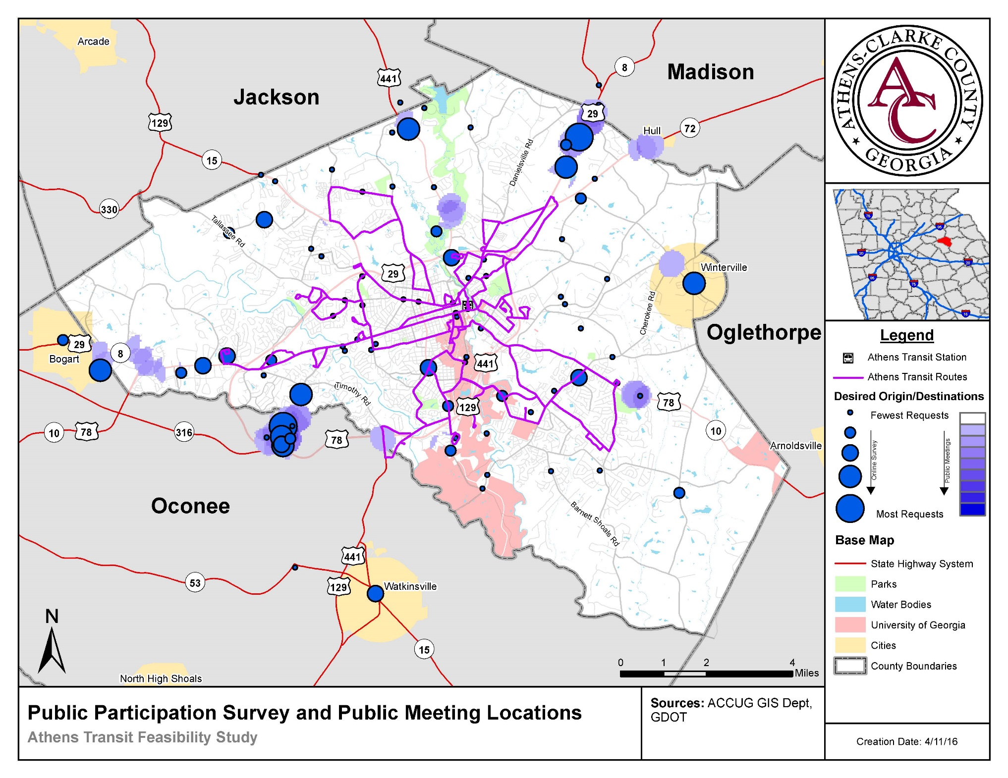
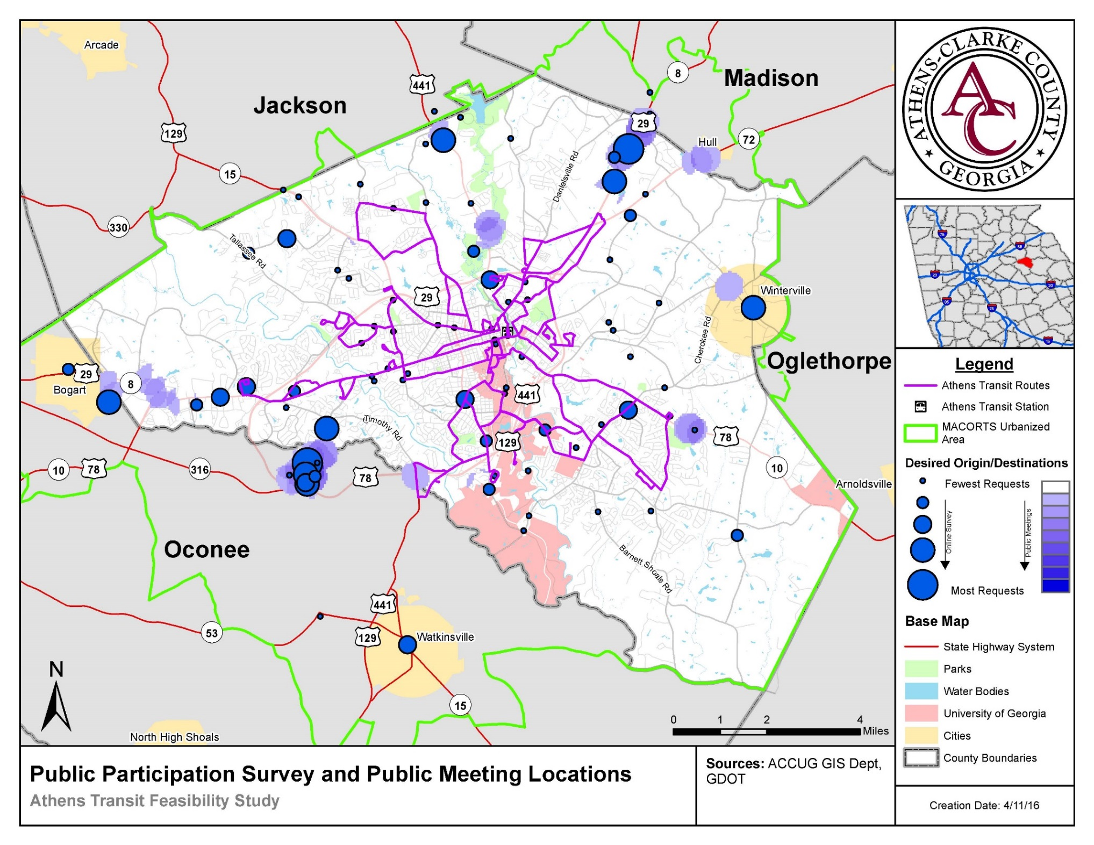
Survey Results: Aggregated Survey and Pin Responses
Aggregated data from Survey and Pin Exercise further demonstrates desired service targets.
Locations and corridors of interest are generally consistent.
Hull and Watkinsville are exceptions

Slide 8
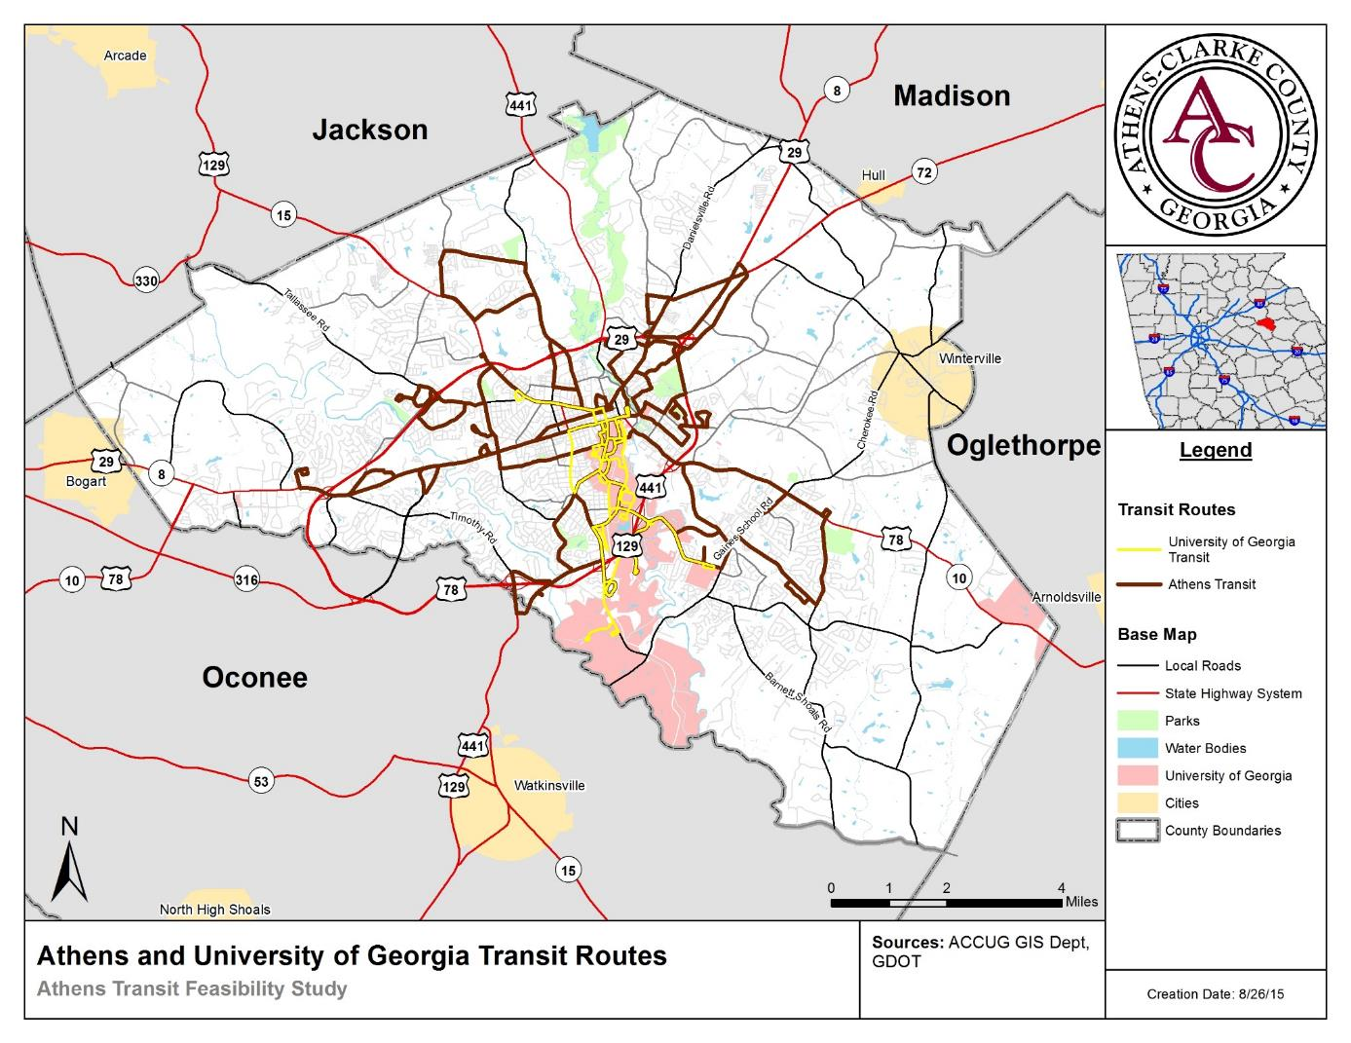
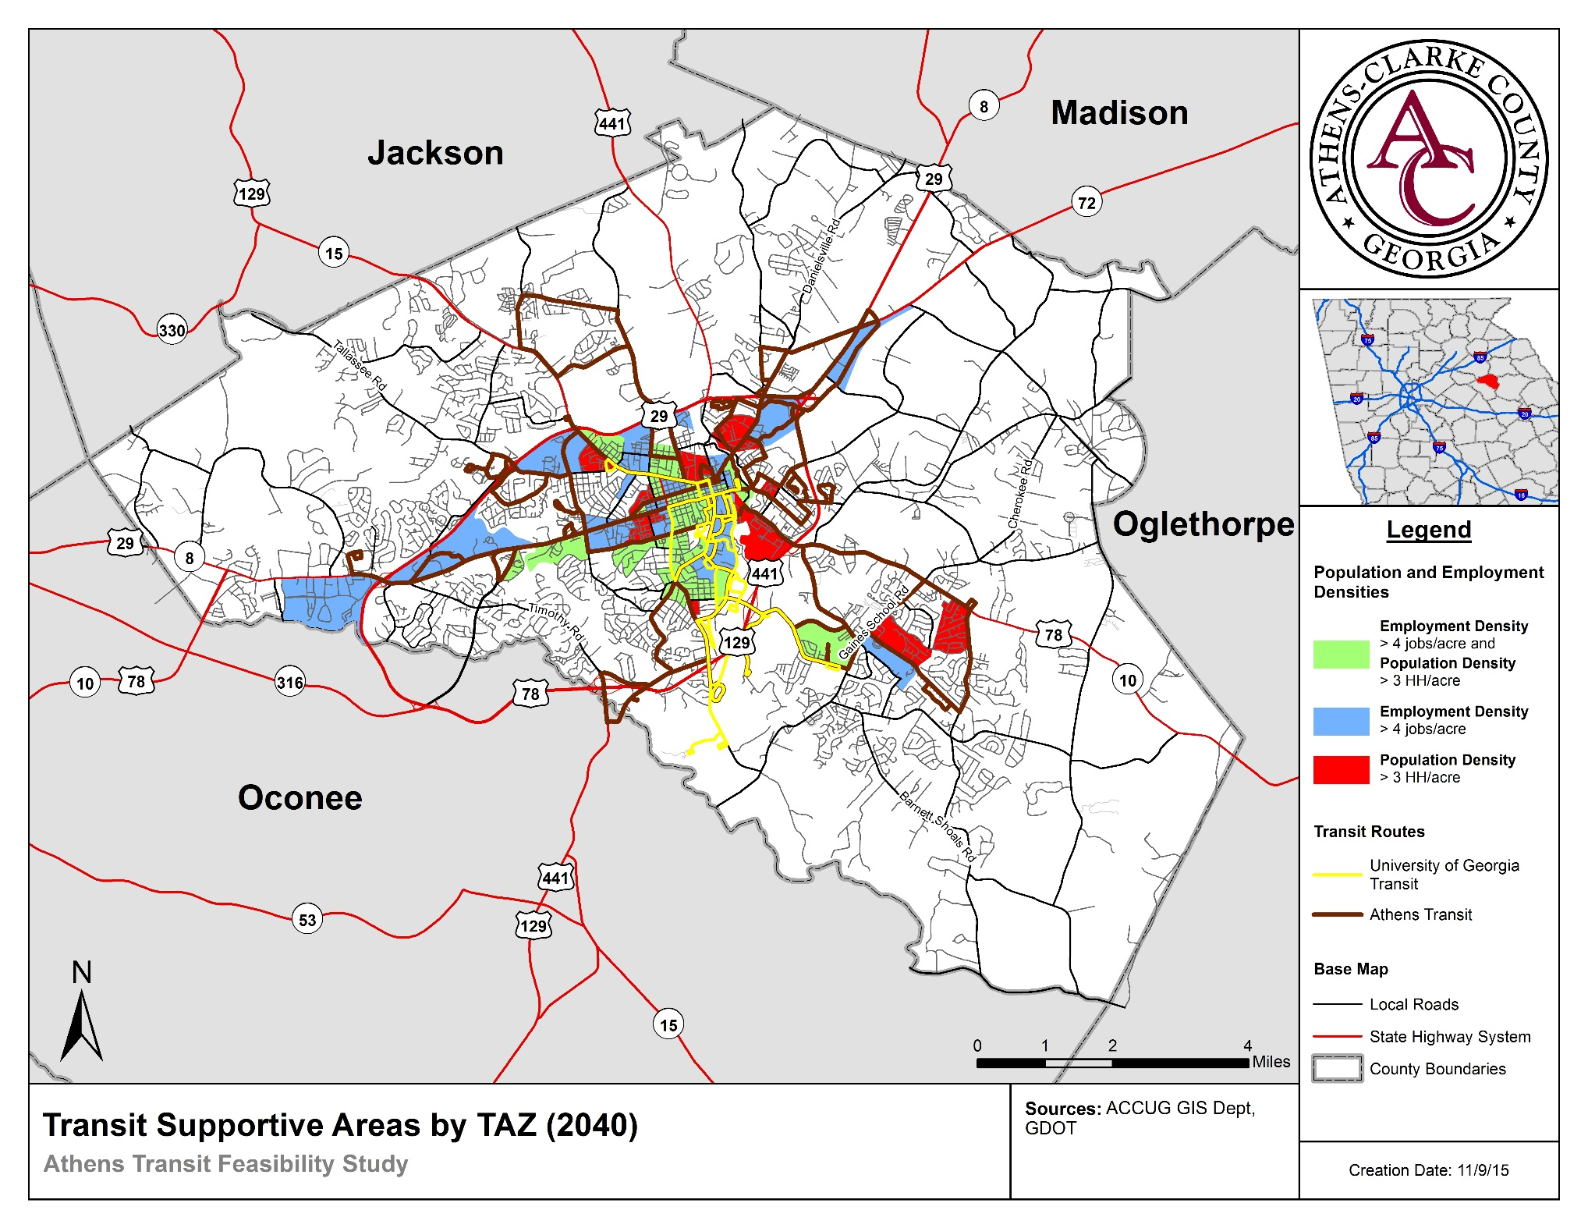
2040 - Future Socioeconomic Conditions: Transit Supportive Areas
Areas with high enough concentrations of employment and/or population to support at least hourly bus service
Transit supportive areas are currently served by transit
Transit Capacity and Quality of Service Manual,
Third Edition, Transit Cooperative Research Program,
Report 165, Transportation Research Board, 2013

Slide 9
DRAFT SERVICE OPTIONS
Draft options identify:
  Short-Term: 1-5 years
  Mid-Term: 6-10 years
  Long-Term: 11-15 years
  Elimination of underperforming route segments
  Expansion of service into new areas and along corridors
  Service frequency
  Elimination of loops where feasible
  Planning level cost estimates
    Capital: Buses, stop amenities, ride guides, marketing materials, increased maintenance, etc.
    Operating: Expanded system operating cost, updates to website, stop notification system, mobile app, google bus, etc.
    Staff: Drivers, route supervisors, and support staff salary and benefits.
Service changes impact existing and potential riders, existing bus stop improvements, and may require installation of new bus stop infrastructure

Slide 10
Service Options: Non-Fixed Route Service Areas
Survey and Public Meeting Results
Latent Demand/Propensity
Existing Conditions Analysis
Insufficient densities to warrant traditional fixed route service.
Requires additional analysis and outreach to identify service strategies.
  DRS, Carpools, Shuttles, Etc.

Slide 11
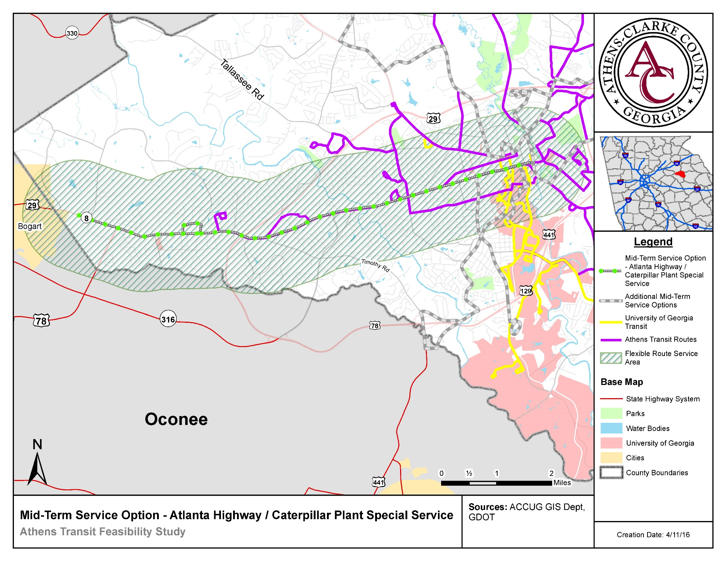
Mid-Term:
Atlanta Highway /Caterpillar Flexible Service
Existing Conditions Analysis
Ridership surveys
Public/Stakeholder input
Growing population and employment density
Flexible pre-scheduled service within 1 mile of route and/or Demand Response van service

Slide 12
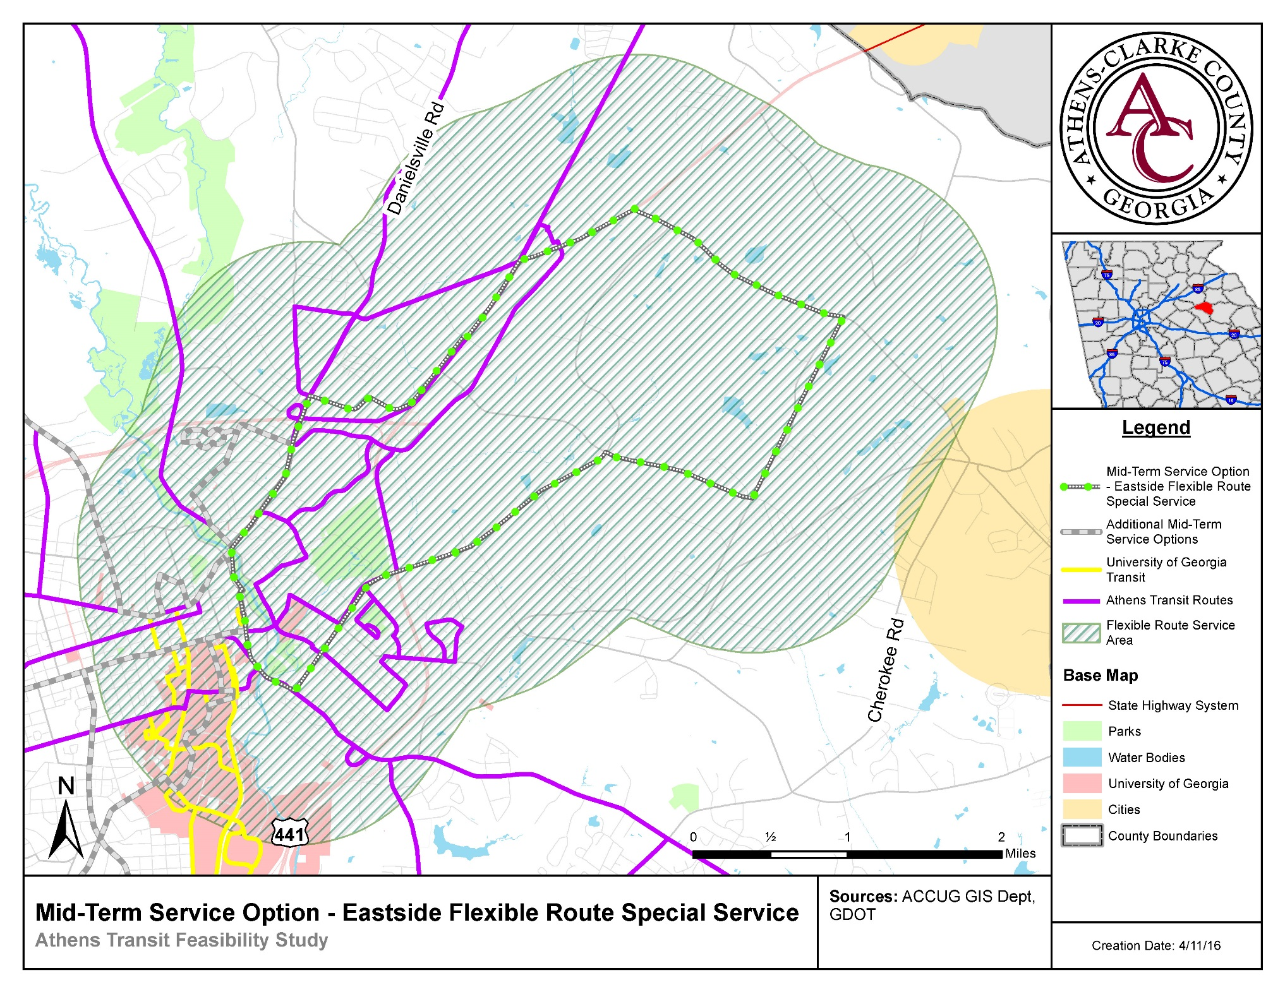
Mid-Term:
Eastside Hancock Industrial Park Flexible Service
Existing Conditions Analysis
Ridership surveys
Public/Stakeholder input
Growing population and employment density
Flexible pre-scheduled service within 1 mile of route and/or Demand Response van service

Slide 13
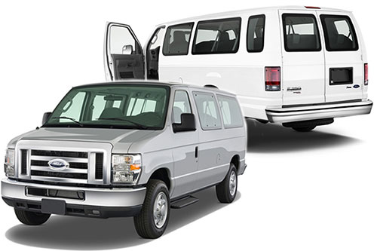
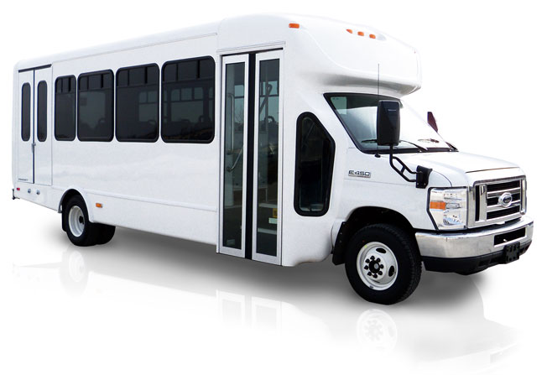
Non-Fixed Route Service Areas
  Service options from vanpool to non-ADA demand response
    Vanpool - $50,000/year operating plus vehicle
      May require multiple vanpools to serve areas
    Non-ADA demand response – $150,000 vehicle
      Based on current DR fully-allocated costs
    Turn-key operations currently available
      Service can be funded by Users
      Schedule Determined by Users

Slide 14
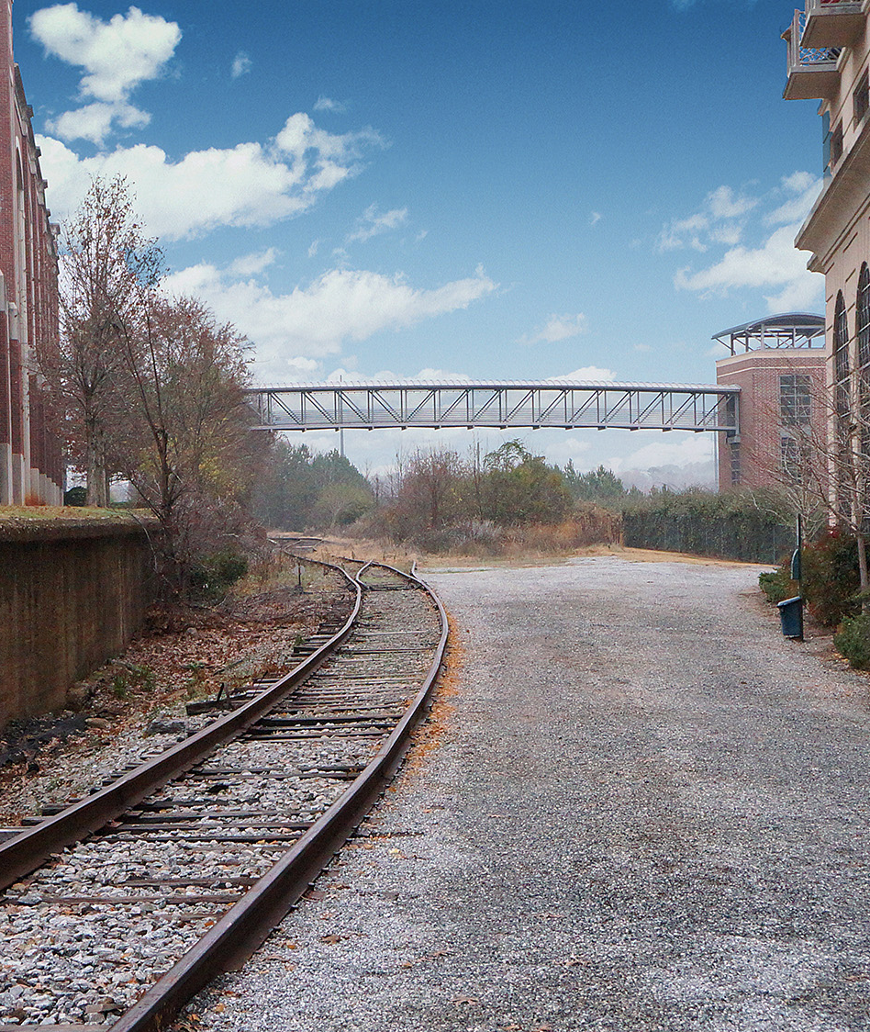
Questions?
54

