Slide 1

Training on FY26 Reporting Process for CDBG, HOME, ARPA and CPP Contracts
This meeting is being recorded!
Housing & Community Development Department
July 2025

Slide 2
Purpose
This training is to explain the process through which contracted agencies will submit their financial and performance measurement reports for FY26 programs funded through CDBG, HOME, ARPA and CPP funding managed by HCD and/or ARPA Team.

Slide 3
Agenda
Staff Points of Contact
Overview of Reporting Process
Performance Reports
Financial Reports
Zoom Grants Demo
Q&A

Slide 4
Introduction to Staff
Melinda Lord, HCD Director Alejandra Calva, HCD Assistant Director
Housing & Economic Dev. | Community Development | Community Impact | Compliance
Marqueta Swain, Administrator | Marci Irwin, Administrator | Cory Scott, Administrator* | Coral Rogers, Administrator
Solomon Smothers, AH Coordinator | Damario Squire, CD Coordinator | Yashu Kavalakuntla, CI Specialist | Santerica Davis, Compliance Specialist
Vacant, AH & ED Specialist | Hannah Savard, Homeless Specialist | Madison Shelnutt, CI Specialist | Lily Sronkoski, Compliance Analyst*
 | Samantha Gambuti, CD Specialist |  | Michele Tully, Program Support Analyst II
 |  |  | Andrea Livingston, Administrative Assistant
ARPA Team*
Paige Seago, Data & Outcomes Coordinator (Budget & Strategic Planning)
Cameron McGlothen, Equity & Engagement Coordinator (People & Belonging)

Slide 5
Staff Points of Contact
Each contract is assigned a “First Reviewer” and a “Second Reviewer”. First Reviewers act as your agency's main point of contact.
If you have multiple contracts with multiple funding streams, you will likely have multiple points of contact.
HCD Housing & Economic Dev. | HCD Community Development | HCD Community Impact | HCD Compliance
HOME CDBG Affordable Housing CDBG Economic Development ARPA Affordable Housing (FY23) | CDBG Public Service CDBG Public Facilities ARPA Homelessness | Community Partnerships Program Neighborhood Leaders | All
ARPA Team
ARPA

Slide 6
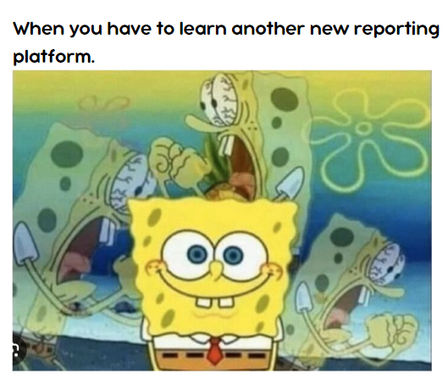
Reporting Process Overview
All contracted agencies must submit:
  Performance Reports (AKA “Monthly Reports”)
  Financial Reports
In FY26, we will use two platforms to accept these reports:
  Survey 123 – Performance Reports
  Zoom Grants – Financial Reports, and certification of Performance Reports

Slide 7
Performance Reports

Slide 8
Performance Reports
What is a Performance Report?
A document that provides updates for the agency’s program. It helps ensure that the agency is on track to fulfilling their goals.
Staff also uses them as a guide when processing financial reports.
Why are they required?
Tax-payer dollars come with reporting regulations.
It helps us tell your agency’s story! We use the data in the Reports to let M&C, HUD/Treasury and the community know about the great work you are doing.
When are they due?
Typically by the 5th of the month, for activities completed the month prior (check your contract!).
We cannot process Financial Reports without a current Performance Report.

Slide 9

Performance Reports
How do I submit Performance Reports?
For FY26, agencies will submit through Survey123 platform.
Why the change?
Easier to enter data every month.
  Personalized to each program and metrics
  Skip logic will populate questions relevant to that specific month (e.g., 3-Month Client Follow Ups)
Helps ensure accuracy with auto-calculations of YTD metrics, etc.
Data will automatically be pulled into publicly-available Program Performance Dashboards (Visit www.accgov.com/arpa for ARPA Dashboard, as example of what’s to come)

Slide 10
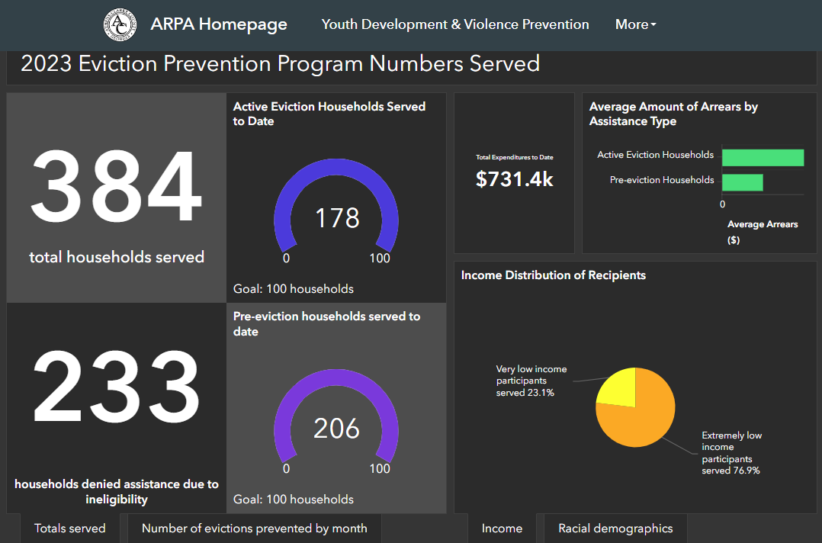
Performance Reports – Sample Dashboard

Slide 11
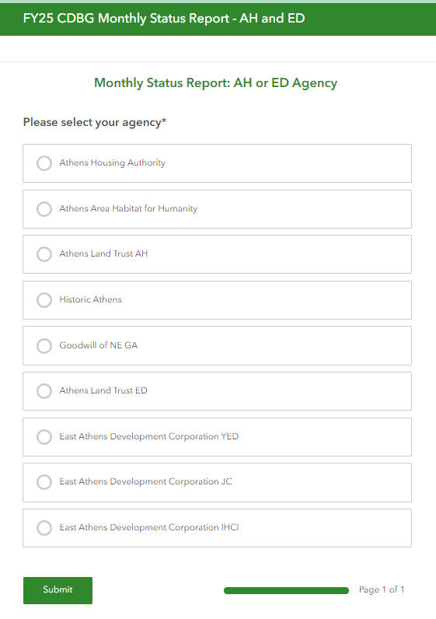
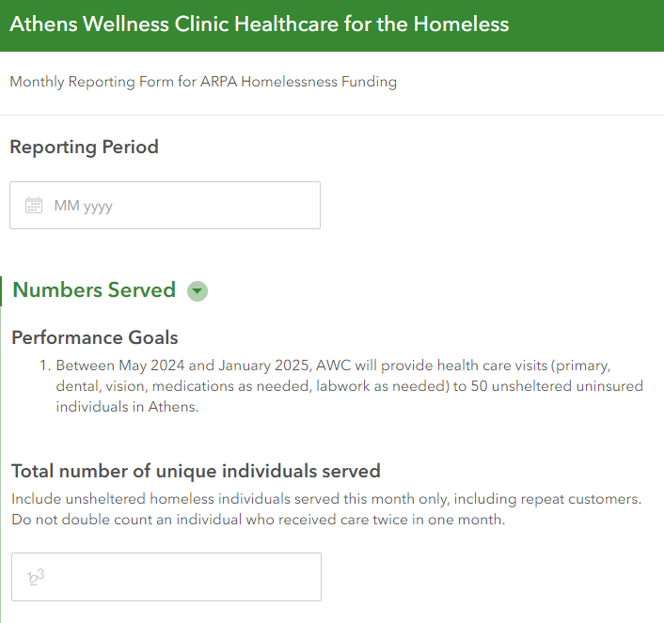

Performance Reports – Survey 123
1
Go to the link provided to you by your Grant Manager.
Make sure you use correct link! (Check Title at top)
Complete all required questions before hitting Submit.
Log into Zoom Grants to complete steps on next slide.
2
3

Slide 12
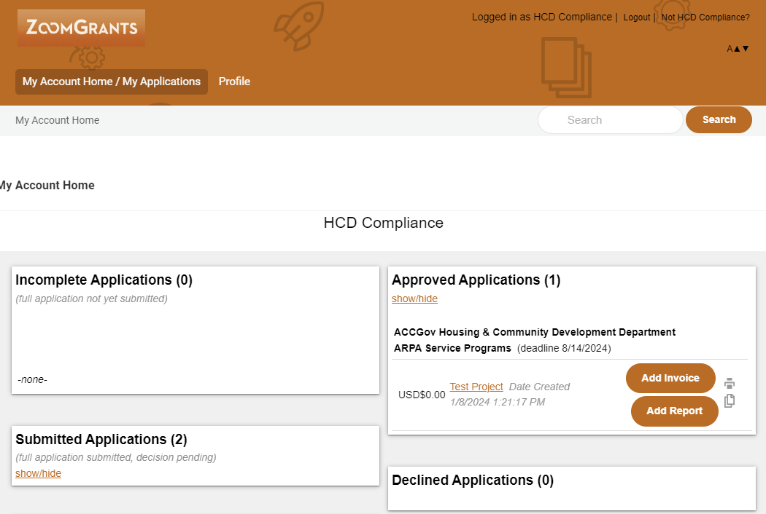
Performance Reports – Zoom Grants
1
Log into www.ZoomGrants.com
Don’t have a log in? Contact your Grant Manager.
Select the program you will be reporting on.
2
Zoom Grants Demo at the end of this presentation – hang tight!

Slide 13
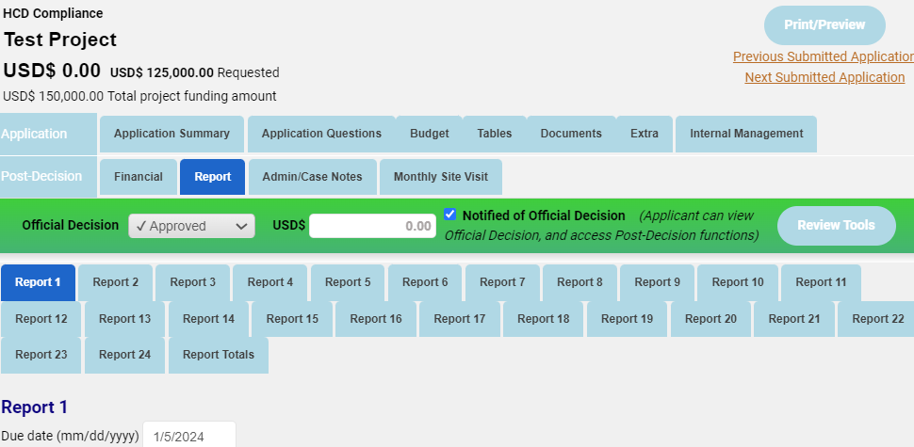
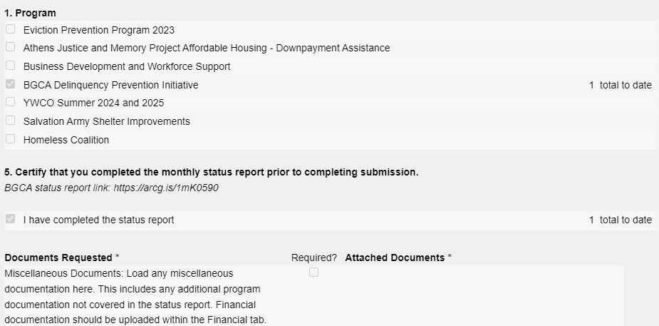
3
Click on “Report” tab on the bottom row of Post-Decision blue tabs. ​
​
Click on the tab at the top with the Report Number you want to complete​.
Use Due Date to confirm you're on the right one!
​
Fill out form with requested information and to certify you completed Survey123.
Click on Submit button at the bottom of the screen.
4
5
6

Slide 14
Questions about Performance Reports?

Slide 15
Financial Reports

Slide 16
Financial Reports
What is a Reimbursement Request?
A financial document submitted by an agency on a reimbursement-based contract, outlining all expenses for which they seek reimbursement.
Payments cannot be processed until the documents are accurate and complete.
What is an Expenditure Report?
A financial document submitted by an agency on an advanced payment-based contract, outlining all expenses on which grant funding has been spent.
If complete and accurate expenditure reports are not submitted on time, agencies risk having next payments held back.

Slide 17
Financial Reports – Key Elements
All Financial Reports must include:
Reimbursement Request or Expenditure Report (known as “Invoice” in Zoom Grants)
Schedule of Documentation (SoD)
Supporting Documentation for every single eligible expense listed in the SoD.
  This includes Administrative costs such as a percentage of rent, insurance, etc.
When are they due?
A least once monthly for activities completed the month prior (check your contract!)
We cannot process Financial Reports without a current Performance Report.

Slide 18
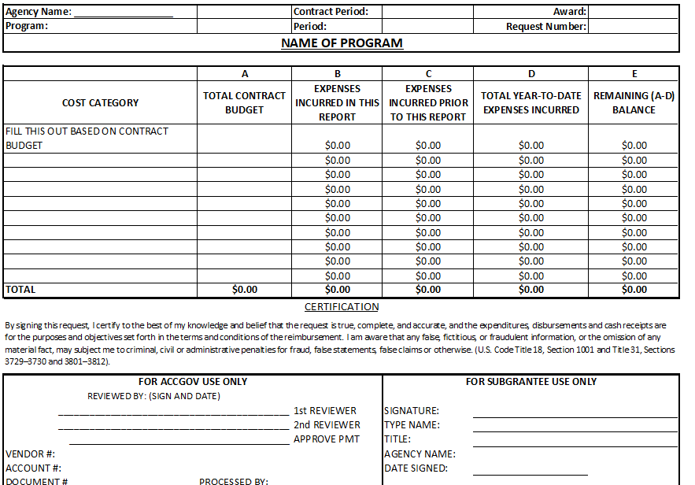
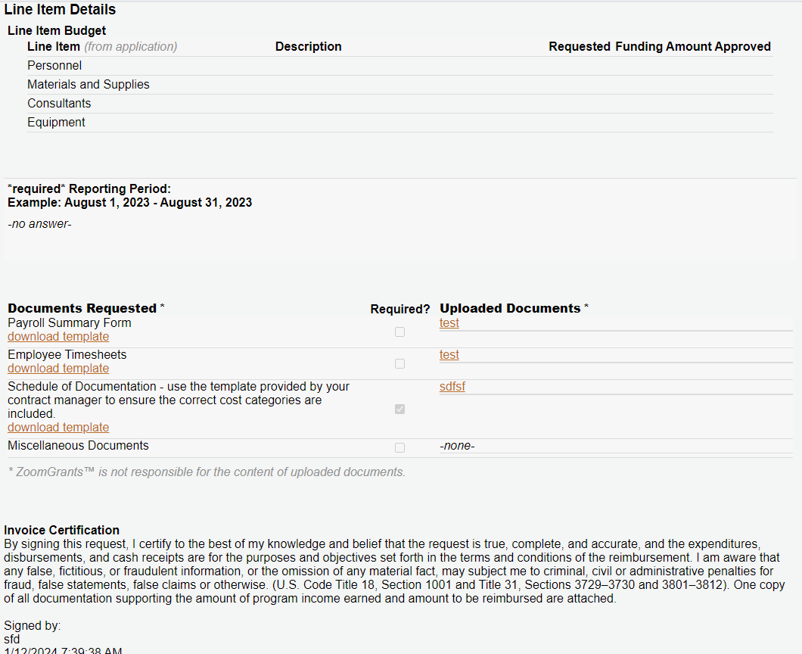
1. Reimbursement Req., Expenditure Report
Overview of your contracted line-item budget, expenses to date & balance
Previous Form
New Zoom Grants "Invoice"

Slide 19
2. SoD
Details all individual expenses incurred during the reporting month, organized by contract budget category
Amounts must match RR/ER
What should you include?
  Only expenses that are allowed by your contract.
  For Reimbursement Contracts: Include all costs incurred in the reporting month, regardless of when it cleared the bank account.
  For Advanced Payment Contracts: Only include expenses that cleared your bank account in the reporting month.

Slide 20
2. SoD
EXAMPLE: Cost was incurred on July 20, but payment didn’t clear bank account until August 10.
Reimbursement Contracts:
  Include expense in July report.
  Include a copy of your August bank statement.
Advanced Payment Contracts:
  Include expense in the August report.
  Include a copy of your August bank statement.

Slide 21
3. Supporting Docs
Submit documentation for every single expense listed in the SoD
Documentation should show:
  Costs were incurred during the reporting period, and within your contract period
  Costs were actually paid out
  Costs are allowable, based on your contract budget and regulations
  Costs were approved by the responsible officials in your agency
NOTE: You MUST submit ALL project bank and/or credit account statements used for project expenses and to which project funds are deposited as part of financial reporting.

Slide 22
3. Supporting Docs
Staff Time:
Time sheets, Payroll Register
Cashed employee checks, evidence of direct deposits
Rent & Utilities:
Itemized invoices or bills
Cashed checks, evidence of direct deposits, proof of payment from vendor
Supplies & Materials:
Receipts or invoices (including itemized charges, date, invoice number, sign-off to indicate goods were received)
Bank/Credit Card statements, copies of cashed checks, evidence of direct deposit

Slide 23
Questions?

Slide 24
Expenditure/Reimbursement Reports – Zoom Grants
1
Log into www.ZoomGrants.com
Don’t have a log in? Contact your Grant Manager.
Select the program you will be reporting on.
2
Zoom Grants Demo at the end of this presentation – hang tight!

Slide 25
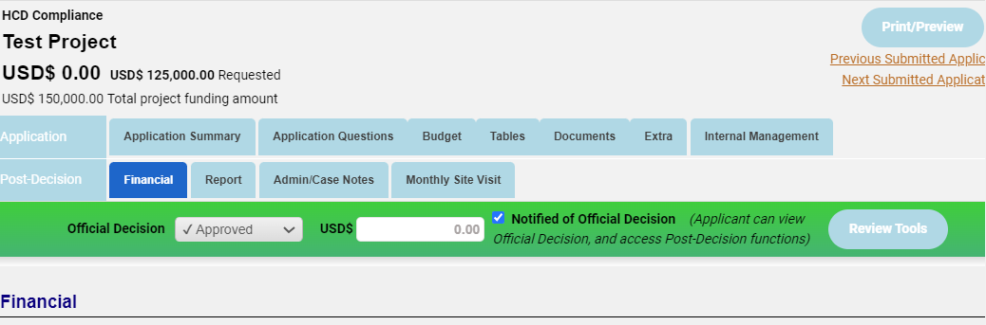
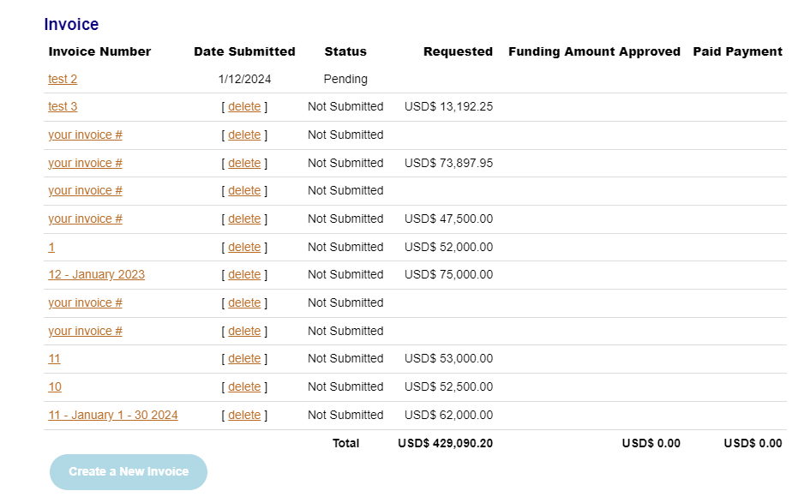
3
Click on “Financial” tab on the bottom row of Post-Decision blue tabs. ​
​
Review status of previously submitted reports
​
Click on Create a New Invoice.
4
5

Slide 26
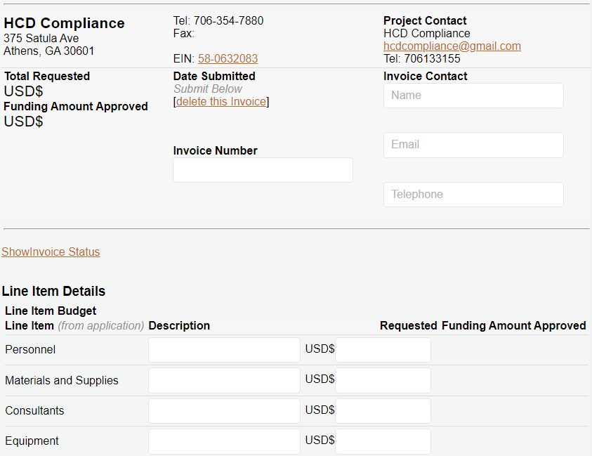
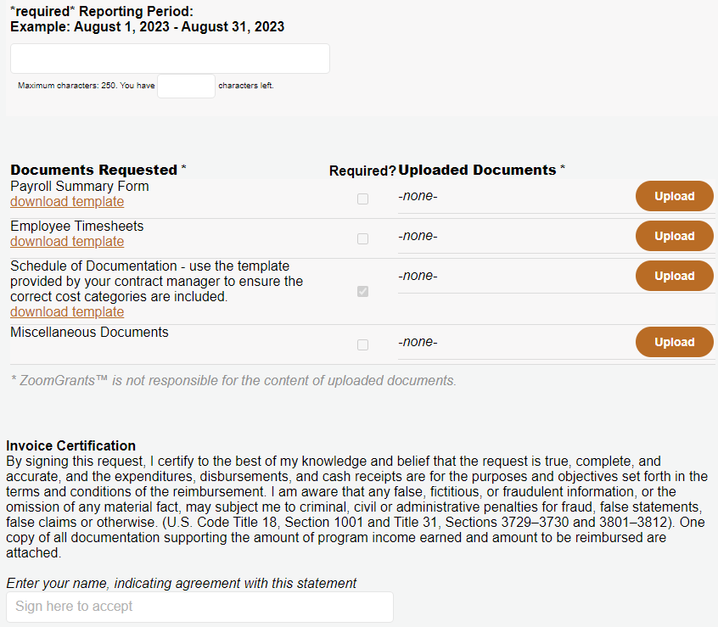

b. Use “Documents Requested” section at the bottom to upload required SoD and Supporting Documentation. Links will provide templates.
6
a. Complete requested information.
c. Read certification and sign, before clicking Submit.

Slide 27
If corrections are needed, your ZG “Invoice” will be returned. To make corrections:
Follow steps on Slide 22 to log in, and select program.
Follow steps on Slide 23 to navigate to Financial Tab.
Click on the Invoice you want to correct (will show as “Not Submitted”).
Make the corrections requested, using steps on Slide 24.
1
2
3
4

Slide 28
Zoom Grants Demo

Slide 29
Q&A

