Slide 1


Technical Standards for Stormwater
Transportation & Public Works Department
December 18, 2024

Slide 2
Purpose
Discuss relevant issues relating to stormwater management in Athens-Clarke County including proposed revisions to Articles 3 (Grading) and 4 (Stormwater) of the Transportation & Public Works Technical Standards.

Slide 3
History
The Federal Water Pollution Control Act of 1948 was largely ignored until . . .
It was amended in 1972 and became commonly known as the Clean Water Act. It was administered by the Environmental Protection Agency.
In 1975, Georgia enacted the Erosion and Sedimentation Control Act.
The 1987 Water Quality Act amended the Clean Water Act to address stormwater. Implementation of stormwater management programs was sourced to local governments.
On March 10, 2003, the Unified Government of Athens-Clarke County (ACCGov) obtained its first NPDES Stormwater Phase II Permit.
Residents in Athens-Clarke County depend upon us look out for long-term stormwater management interests. We are held accountable by the Georgia Environmental Protection Division for the parts of our program specified in our Permit. Other parts of our stormwater management plan are based on where we see additional responsibility to the community.
This is our program.

Slide 4
Things We See Happening
Predictions of increasing intensity of rain events and warmer weather
Numerous residential drainage complaints
People point out that we have issued permits for site design and construction
Lawsuits
Streambank erosion
Failure of public stormwater infrastructure in Athens-Clarke County
Increasing numbers of billion-dollar disasters nationwide
Decreasing participation in the National Flood Insurance Program nationwide
5.7 million policies – 2009, 4.7 million policies - 2023
Increasing property insurance rates
High rents and unaffordable housing

Slide 5
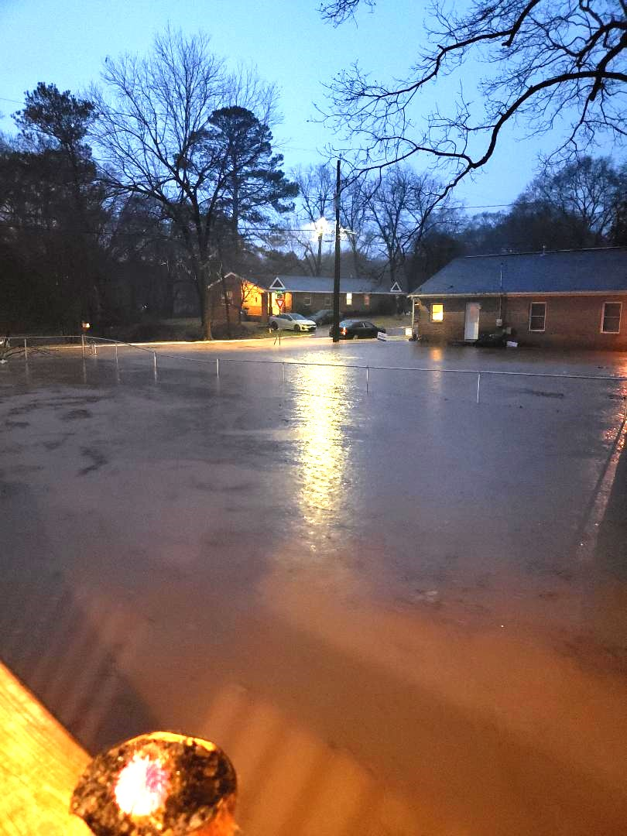
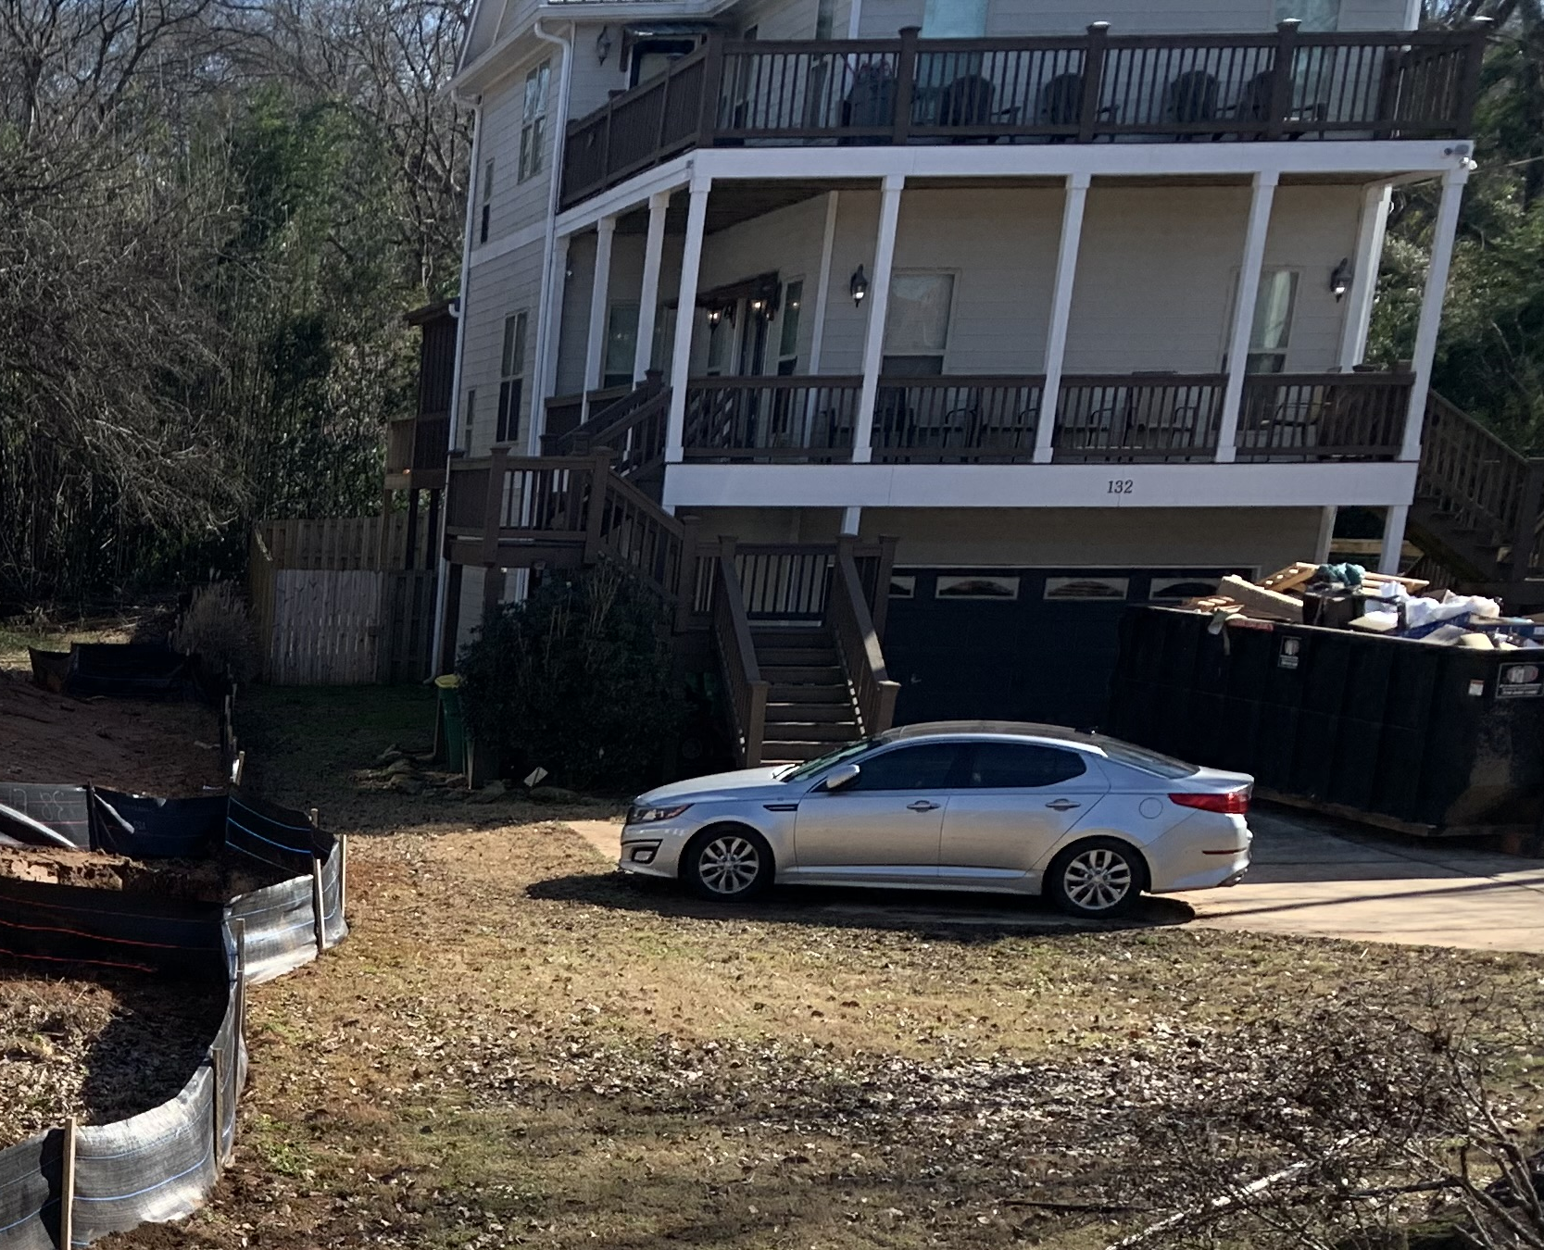
Head Street
132 North Poplar Street

Slide 6
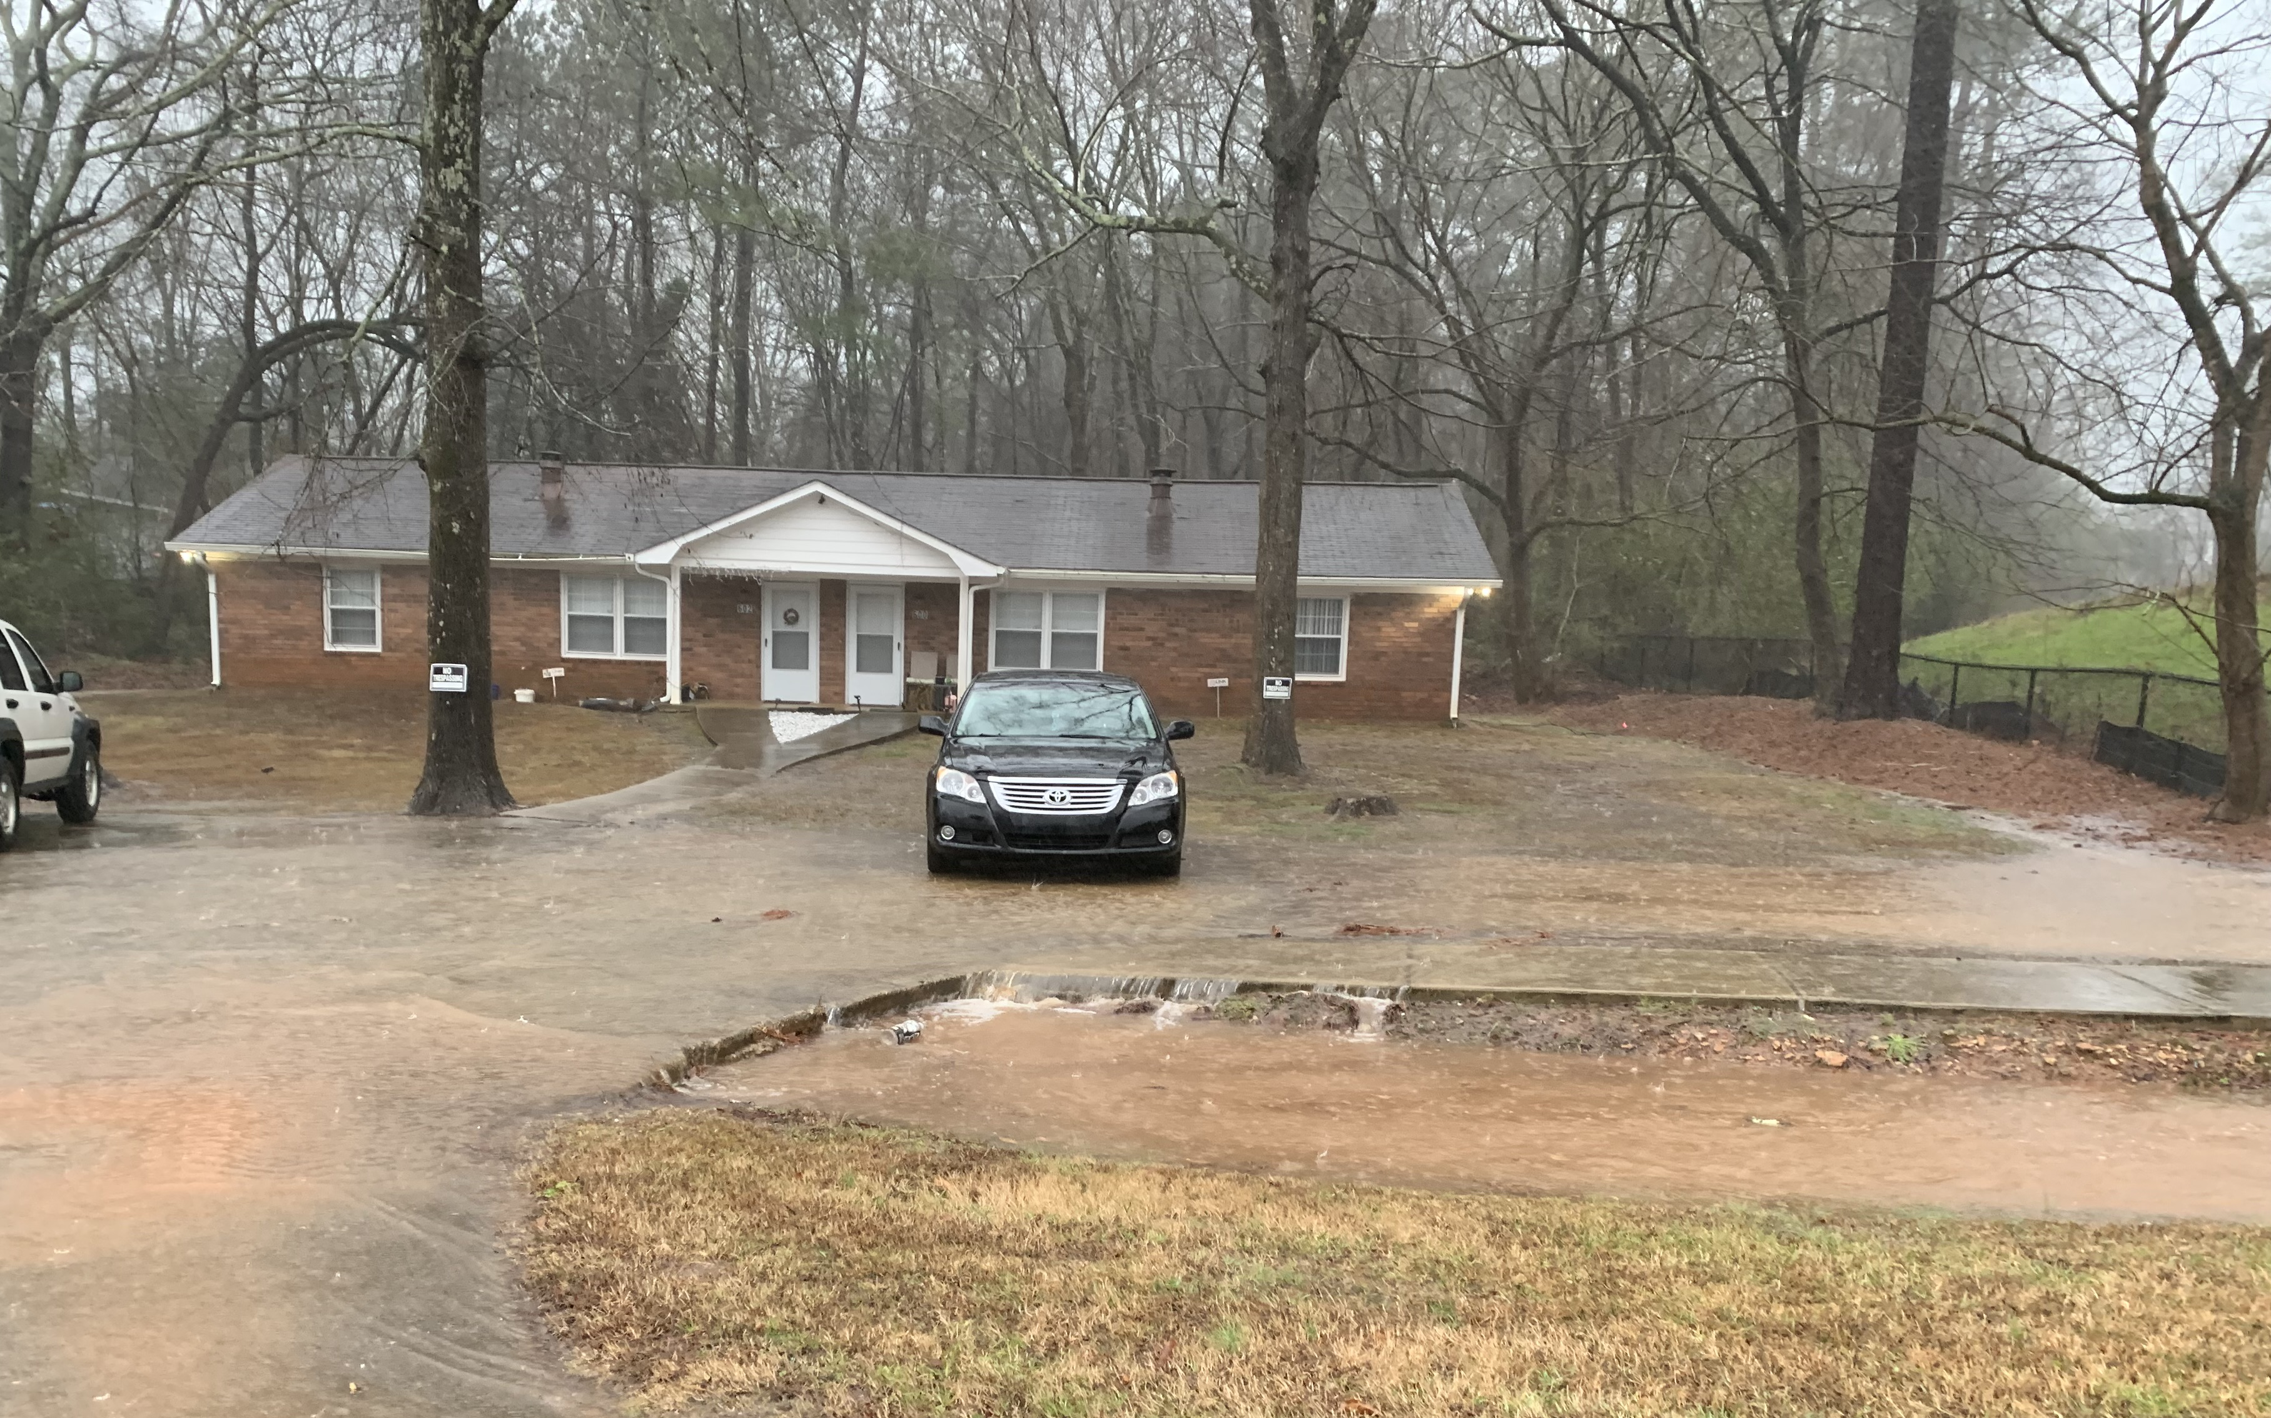
600 Freeman Drive

Slide 7
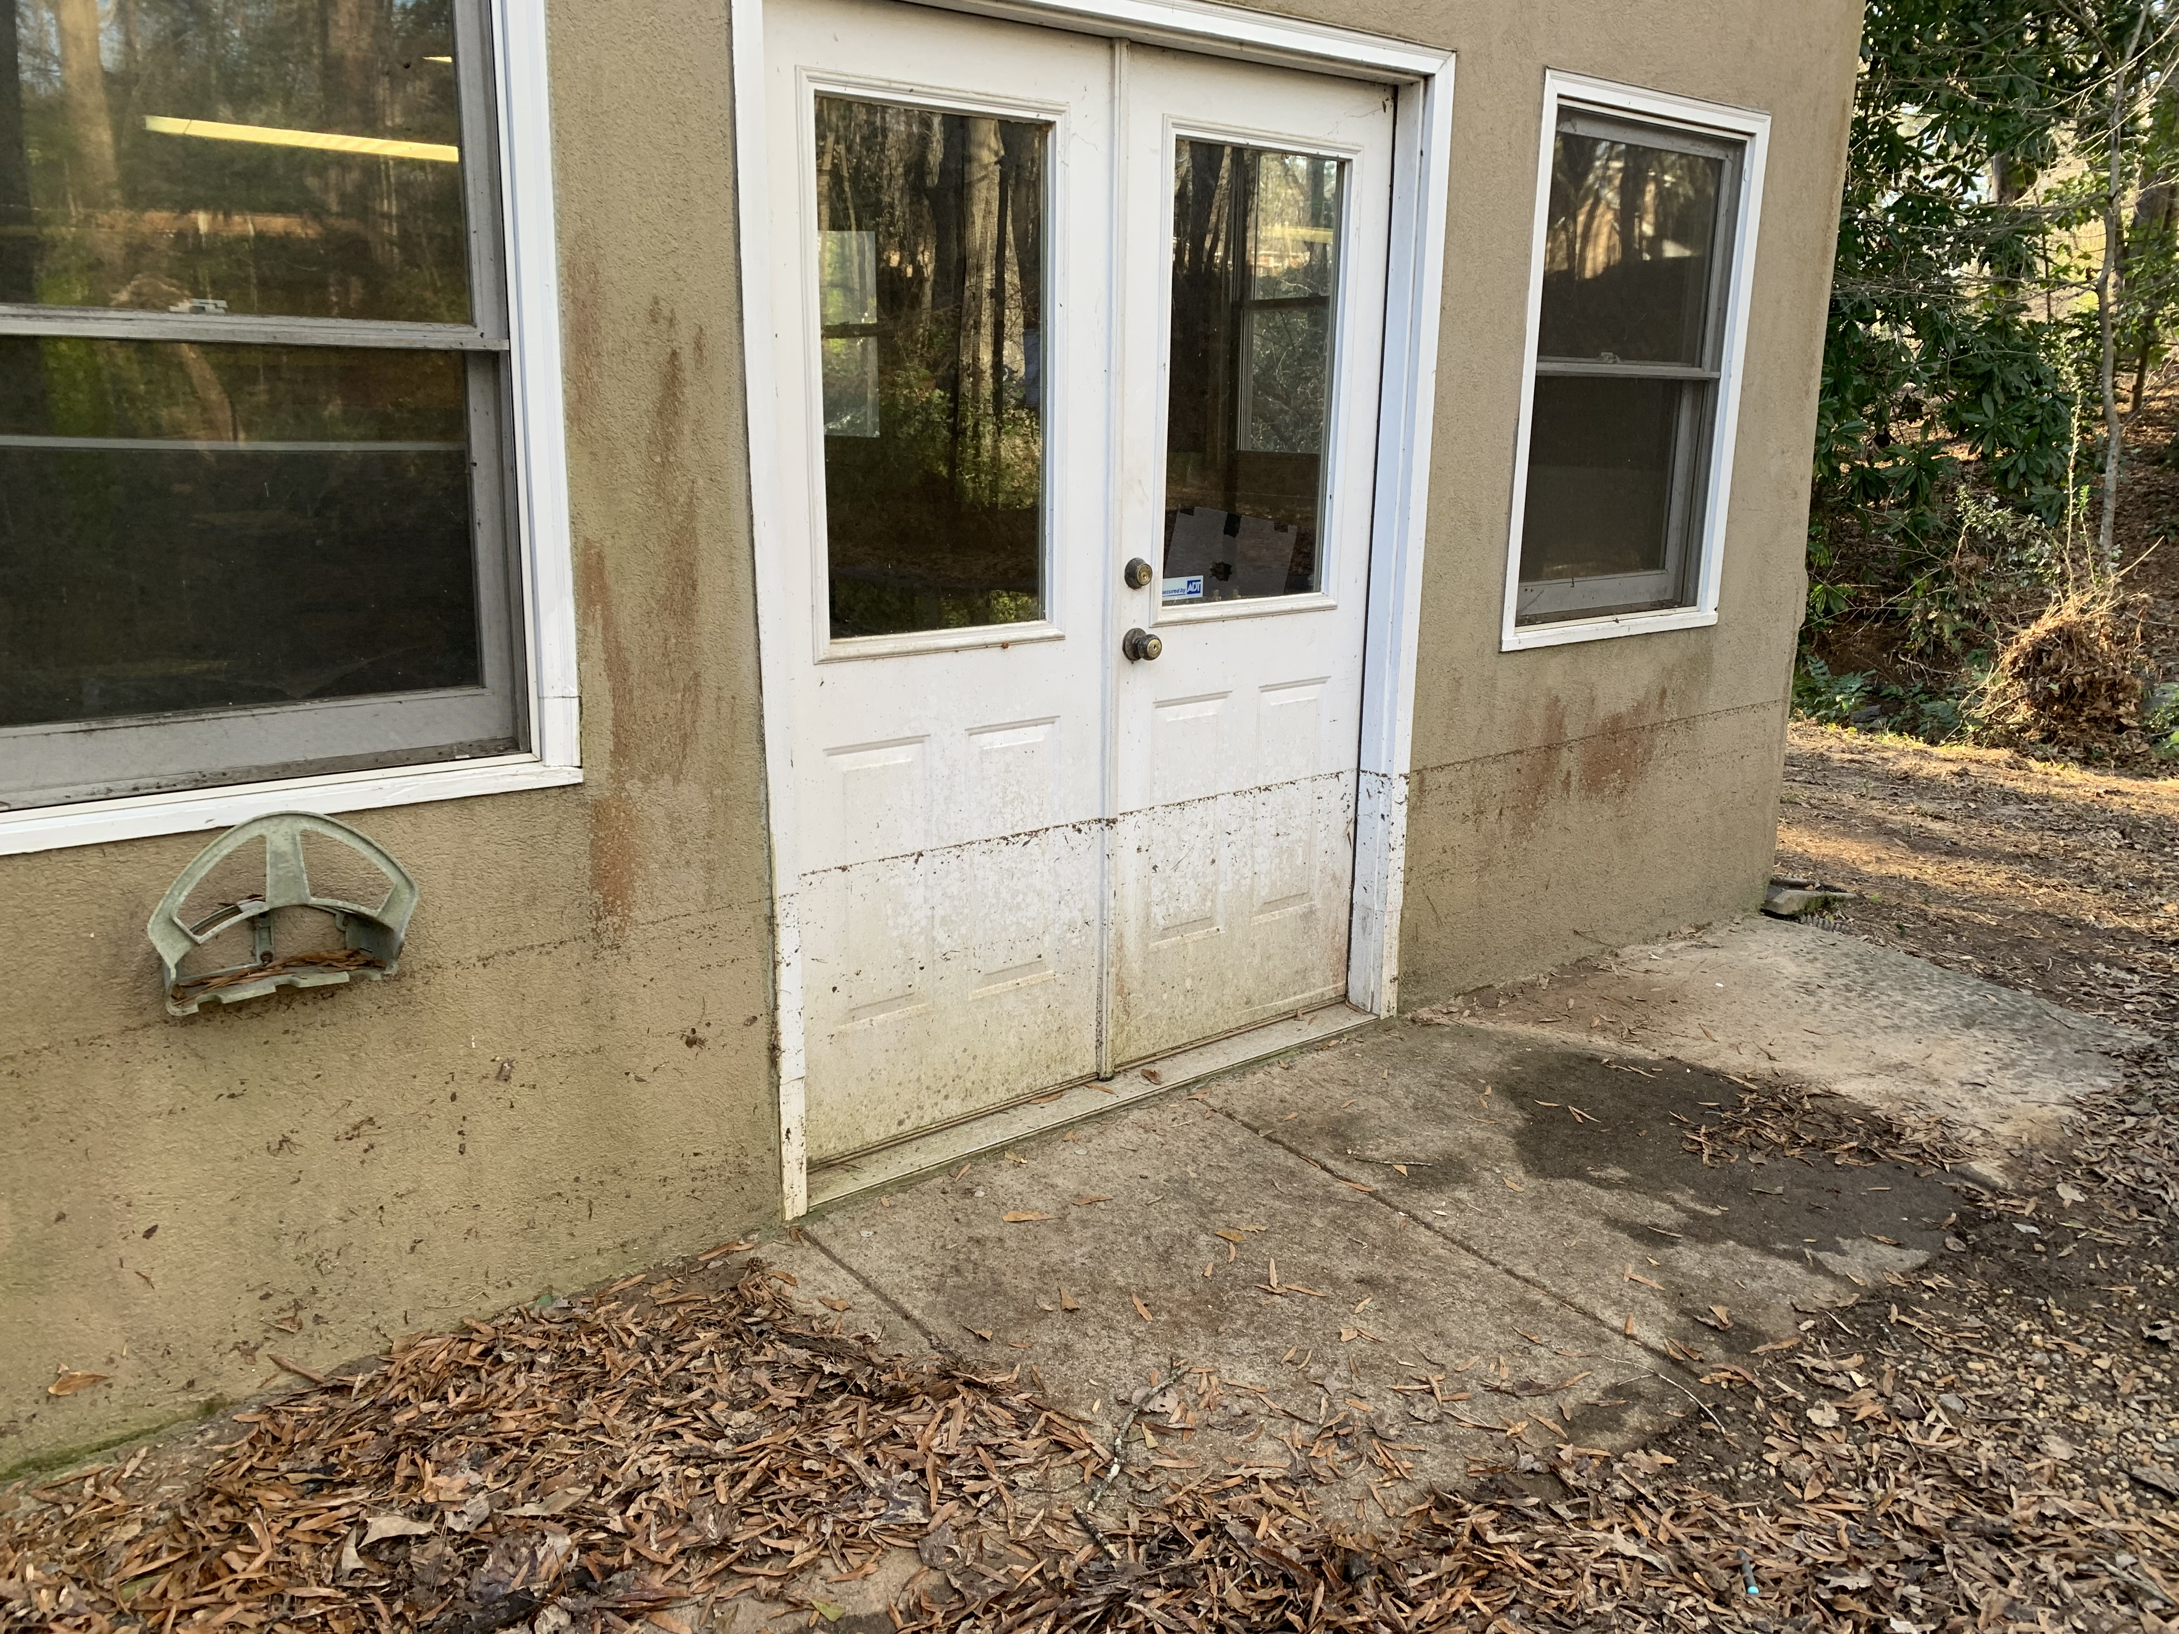
150 Tuxedo Road

Slide 8
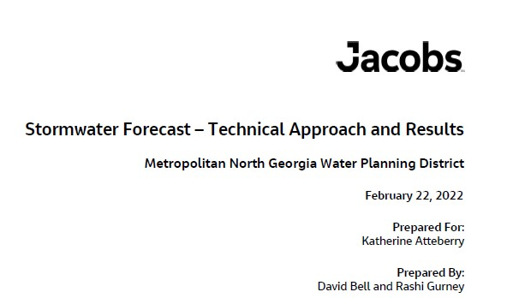

Slide 9
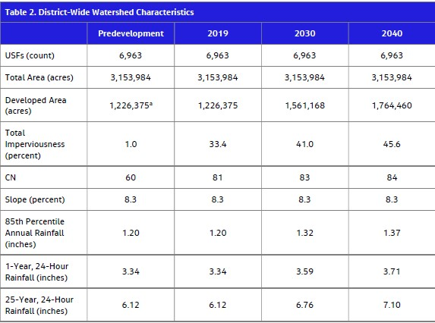

Slide 10
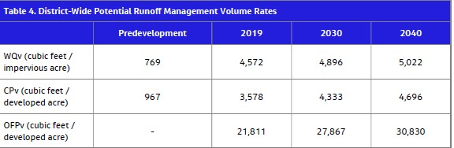

Slide 11
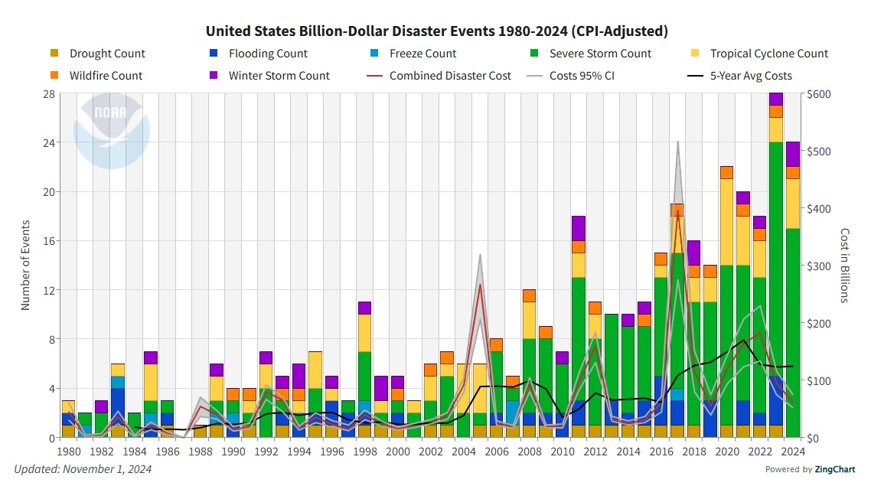

Slide 12
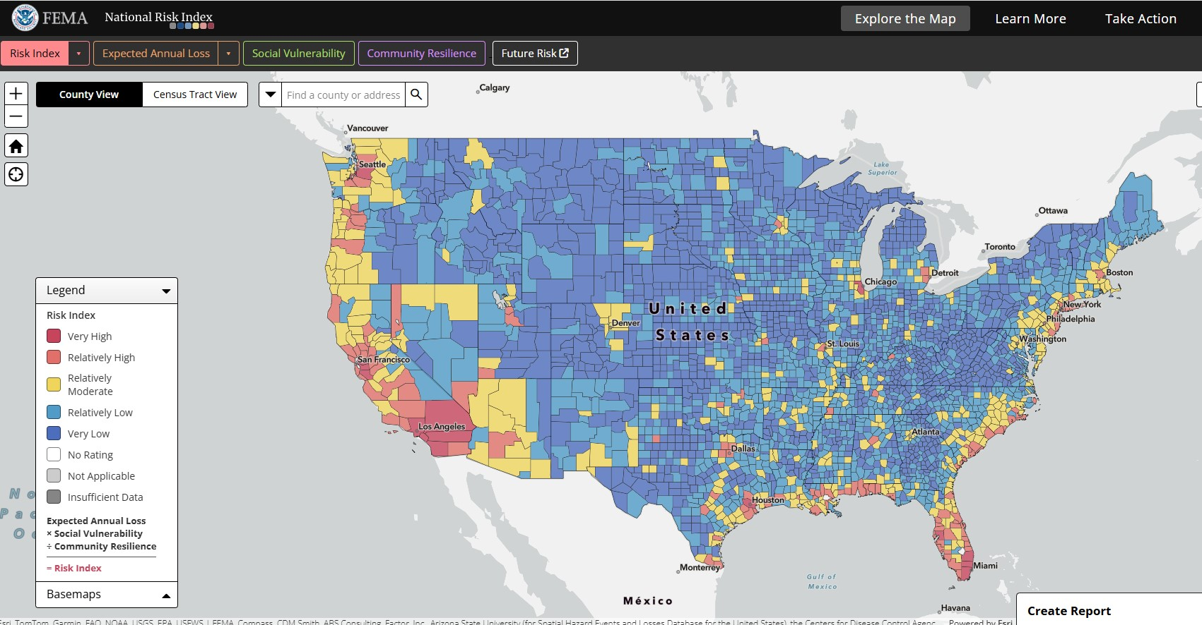

Slide 13
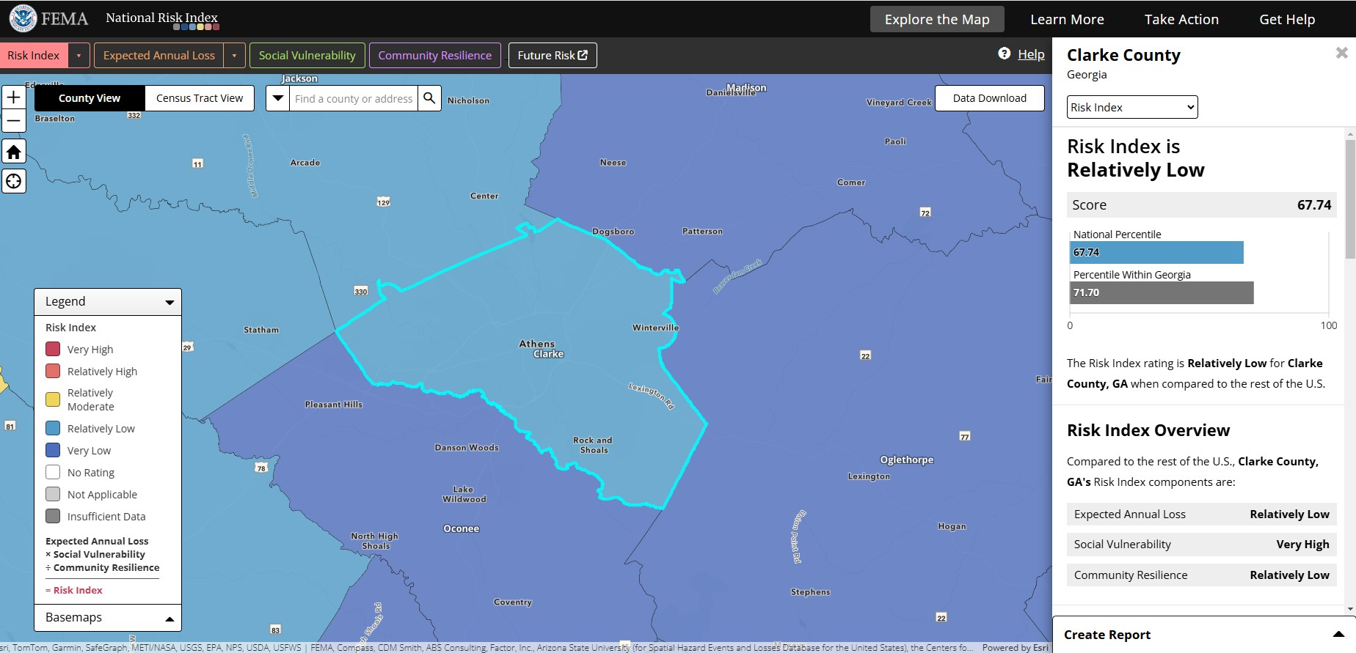

Slide 14
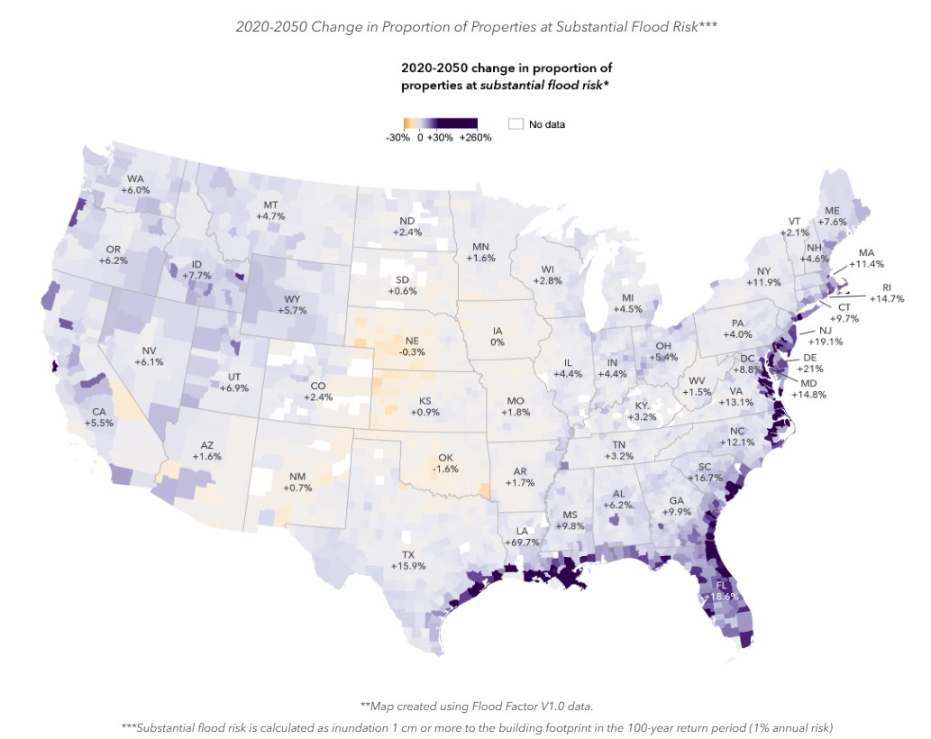
First Street – 2020-2050 change in proportion of properties at substantial flood risk

Slide 15
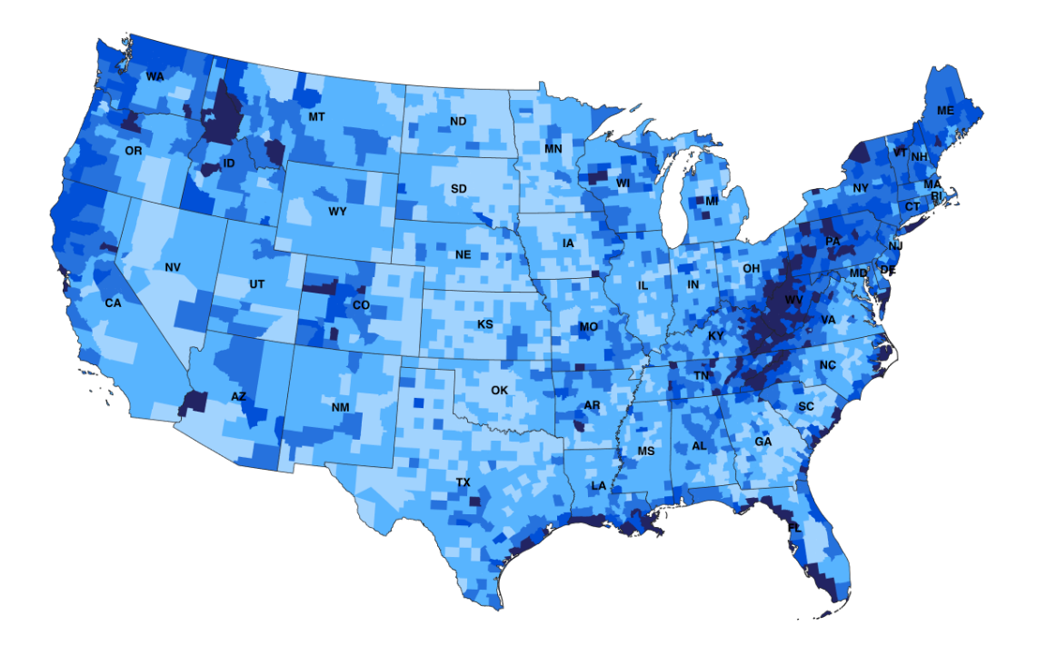
First Street - Flood Factor

Slide 16
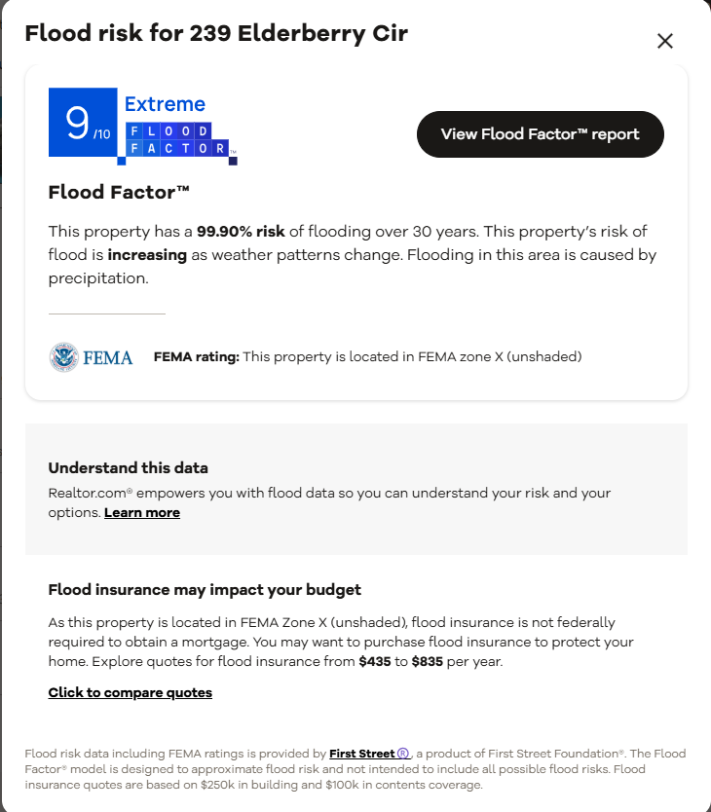
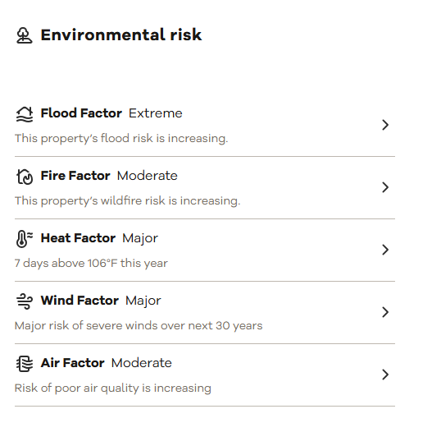
Realtor.com

Slide 17
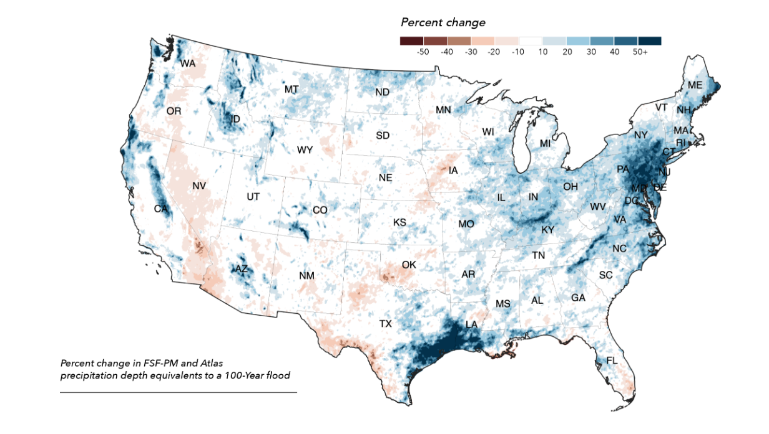
First Street – Projected Change in 100 year flood.

Slide 18
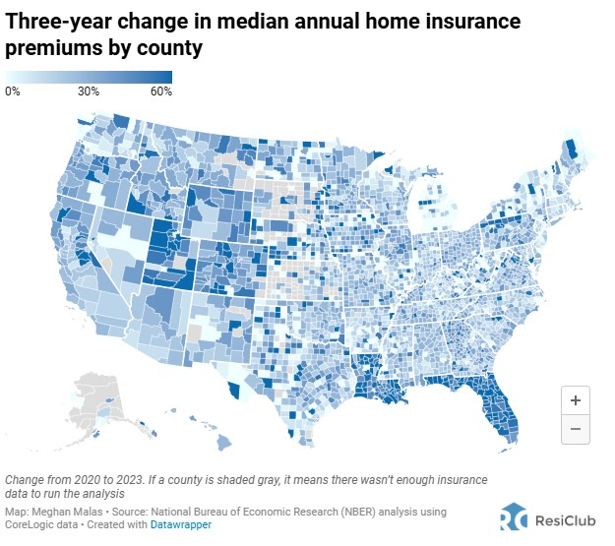

Slide 19
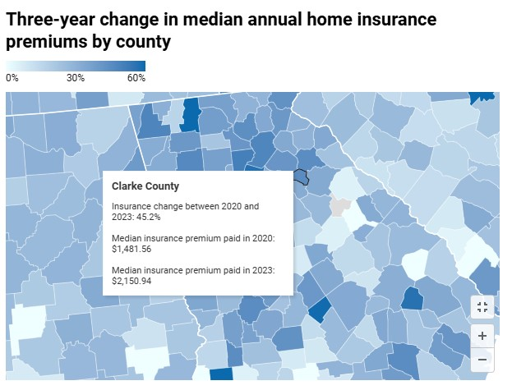

Slide 20
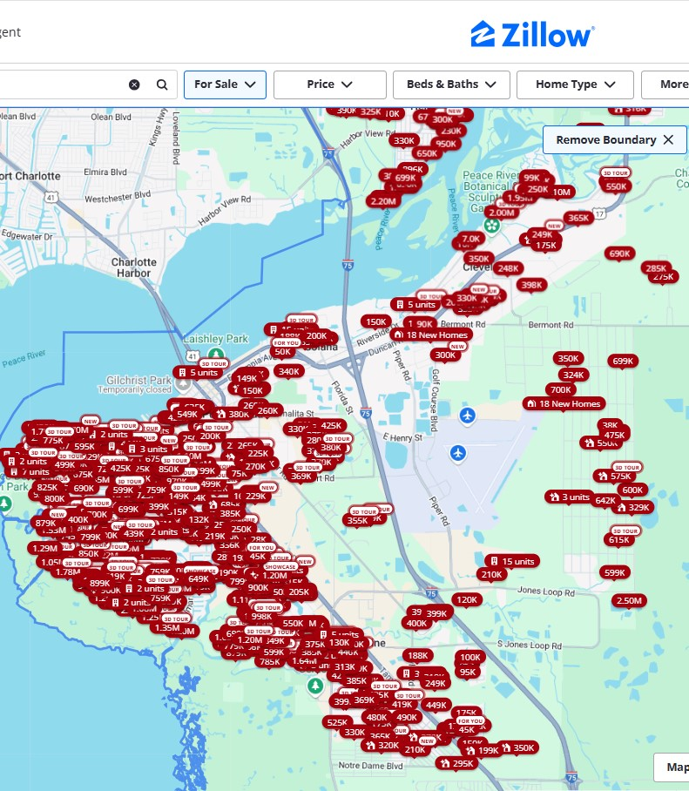
Punta Gorda, FL
Zillow For Sale listings
December 18, 2024

Slide 21
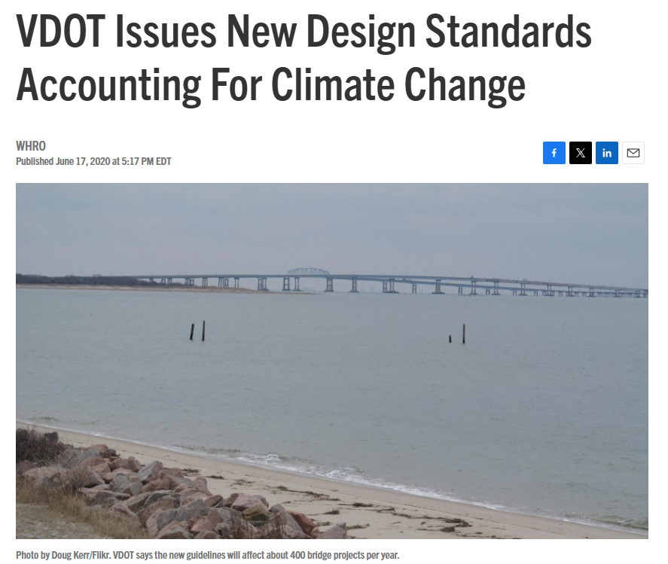
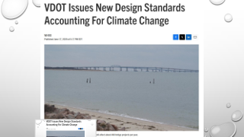


Slide 22
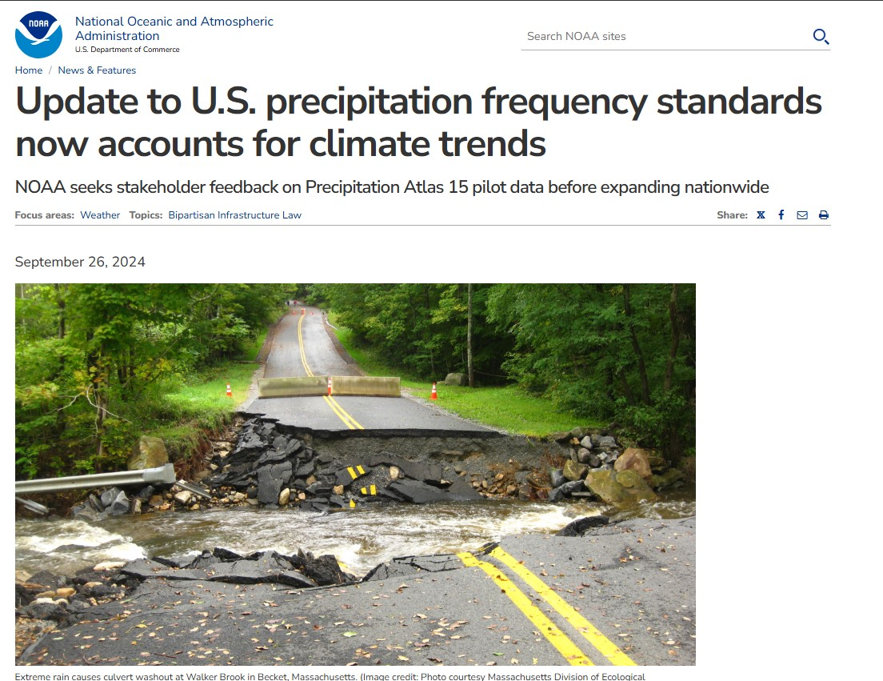

Slide 23
Stationarity is dead.

Slide 24
Housing Prices (from Zillow)
Jurisdiction | 2024 Average Home Price
Athens-Clarke County | $346,682.
Hall County | $378,720.
Gwinnett County | $409,572.
Forsyth County | $610,837.
Roswell | $638,910.

Slide 25
Application of the full EPD stormwater standards for new development only partially mitigates stormwater impacts. Newly developed sites produce more stormwater runoff than in the predeveloped state. More severe flooding occurs downstream, and sometime drainage and flooding problems occur within new development sites. Developed sites are generally warmer than pre-developed sites. They contribute thermal pollution to streams and rivers. Severe rain events and temperatures are predicted to increase.
As opposed to the traditional view of stormwater as a waste product, stormwater can be managed as an amenity. This benefits the long-term interests of residents of Athens-Clarke County.
“. . . While the Clean Water Act gives EPA the authority to set stormwater management benchmarks for entire communities or watersheds, it provides little authority over the shifts in urban growth patterns that are necessary to avoid generating new sources of stormwater pollution. Without local efforts to adopt sustainable comprehensive urban growth plans, it is very difficult to adequately protect the health of local waterways over time. American Rivers Local Water Policy Innovation

Slide 26
Low Impact Development (from Blue Book)
“Much of the guidance in Volume 1 is focused on the concept of LID, and the idea that implementation of LID can help communities achieve social and economic goals while they improve their natural resources. Low Impact Development is an approach to land development or redevelopment that seeks to emulate the natural water cycle as much as possible and reduce the negative impacts of development and impervious cover. This is done by minimizing the production of runoff through the application of better site design techniques that direct development to appropriate areas, preserve natural features that aid in water management, and minimize impervious cover.”

Slide 27
Better Site Design (from Blue Book)
“Addressing stormwater management begins with the site planning and design process. Development projects can be designed to reduce their impact on watersheds when efforts are made to conserve natural areas, reduce impervious cover, and better integrate stormwater treatment. By implementing a combination of these nonstructural approaches, collectively known as Better Site Design (BSD), it is possible to reduce the amount of runoff and pollutants generated by a site and provide for some nonstructural on-site treatment and control of runoff. The goals of Better Site Design include:
Preventing stormwater impacts rather than mitigating them
Managing stormwater (quantity and quality) as close to the point of origin as possible and minimizing collection and conveyance
Utilizing simple, nonstructural methods for stormwater management that are lower cost and lower maintenance than structural controls
Creating a multifunctional landscape
Using hydrology as a framework for site design”

Slide 28

Redevelopment in Athens-Clarke County
There is a risk that the Stormwater permit changes (replacement of impervious surface) required by the EPD would restrict redevelopment opportunities thereby
incentivizing green field development and depleting the inventory of valuable green space,
missing opportunities to improve runoff from existing developed sites, and
risking new development moving outside of Athens-Clarke County.
Consequently, pollutant loadings to ACC waterways may not be reduced to the maximum extent practicable.

Slide 29
Special Standards for Redevelopment
To preserve green space, encourage smart growth, and to reduce stormwater pollutant loadings to receiving streams in Athens-Clarke County to the maximum extent practicable, special stormwater standards are proposed for replacement of existing impervious surfaces (such as a building replacing a parking lot) in certain cases.
Apply the full unified stormwater criteria to added impervious surfaces even if these added surfaces are part of a redevelopment project.
Point to future permit requirements by embracing better site design and green infrastructure.
Landscaping amenities in urban environments
Multiple uses
Incentivize

Slide 30
Metropolitan North Georgia Water Planning District
Policy on Practicability Analysis for Runoff Reduction
Introduction
Runoff reduction practices are stormwater Best Management Practices (BMPs) used to disconnect impervious and disturbed pervious surfaces from the storm drainage system. The purpose is to reduce post-construction stormwater runoff rates, volumes, and pollutant loads. Runoff reduction is more than simple infiltration. The Runoff Reduction Volume (RR_{V}) is the retention volume calculated to infiltrate, evapotranspirate, harvest and use, or otherwise remove runoff from a post-developed condition to more closely mimic the natural hydrologic conditions.

Slide 31

Runoff Reduction
Better Site Design
Green Infrastructure
Low Impact Development
Race to the bottom

Slide 32
Proposed Policy for Maximum Extent Practicability for Runoff Reduction
Special Standards for Replacement of Impervious Area
Policy for Linear Projects funded by Athens-Clarke County
New Impervious Surface Area
Shallow bedrock
High seasonal water table
Utilities
Brownfield
Historic resources
Other factors increasing project cost >20%
Alternative to runoff reduction
Water quality practice for 1.2 inches of rain plus extended detention for 1 year-24 hour rainfall (channel protection).
Or, enhance water quality, extended detention, or peak flow detention based on funding from 20% of project cost.

Slide 33
Mass Grading – Planning Land Use Subcommittee
Desired outcomes
Improve stormwater facility design throughout construction
Allow for the conservation of native top soil on-site
Allow for preservation of natural features (trees, open water, wetlands, floodplain)
Committee Recommendations
Remove exemption for construction of stormwater practices on steep (25%) slopes
Additional grading plan for lots smaller than ¼ acre
Construction buffer standards and/or enhanced tree preservation standards
Technical Standards
Soil preservation and restoration
Runoff reduction – better site design, low impact design, green infrastructure

Slide 34
Technical Standards – Tables
Structure Data
Storm pipes
Inlets
Manholes
Topsoil Management
Lowest Adjacent Grade (flood prevention)
Single Family Residential
Green Roofs
Detention Basin Elevation-Discharge-Capacity
Stormwater Control Measure

Slide 35
TOPSOIL MANAGEMENT TABLE
Project Phase | Area cleared acres | Topsoil to be re-used on site cubic yards | Topsoil to be removed from site cubic yards | Topsoil Re-used on Site
 |  |  |  | Ditches/Swales |  | Other Stormwater Control Measures |  | Other
 |  |  |  | acres | cubic yards | acres | cubic yards | acres | cubic yards
1
2

Slide 36
DETENTION ELEVATION-DISCHARGE-CAPACITY TABLE
Outlet Control Structure Description | Depth (feet) | Elevation (feet) | Total Discharge (Cubic feet per second) | Capacity (Cubic feet)
Bottom of bioretention media | 0 | 757 | 0 | 0
4” underdrain overflow crest restricted to 1 “ orifice | 3 | 760 | 0.05 (infiltration and evapotranspiration) | 1000
Ground at base of OCS | 4 | 761 | 0.1 (infiltration + evap + underdrain overflow) | 1500
2” orifice invert for channel protection volume | 4.5 | 761.5 | 0.15 | 2000
10” weir crest for overbank flood protection | 5.5 | 762.5 | 0.2 | 4000
 | 6 | 763 | 1.5 | 5,500
 | 7 | 764 | 3 | 8,000
12’ OCS weir with 12 inch RCP outlet pipe | 8 | 765 | 4 | 10,000
5’ emergency spillway invert | 9 | 766 | 7 | 15,000
50’ top of berm | 10 | 767 | 7.5 | 20,000

Slide 37
LOWEST ADJACENT GRADE TABLE
Lot Number | Contributing Basin Area (acres) | Channel Bottom Elev. (feet, NGVD) | 100-Year Flood Depth (unless FEMA base flood elevation exists) (feet) | 100-Year Flood Elevation translocated to building location. | Planned Lowest Adjacent Grade (feet, NGVD)
 | >2 to 5 |  | 2.5
 | >5 to 10 |  | 3.0
 | >10 to 15 |  | 3.25
 | >15 to 20 |  | 3.5
 | >20 to 30 |  | 4.0
 | >30 to 50 |  | 5.0
 | >50 to 100 |  | 6.0
 | >100 to 150 |  | 7.0
 | >150 to 200 |  | 8.0
 | >200 to 300 |  | 9.0
 | >300 to 450 |  | 10.

Slide 38
STORMWATER CONTROL MEASURE CAPACITY TABLE
Stormwater Control Measure (SCM) | Contributing Basin Area (CBA) - acres | 100 Year High Water Elevation feet | Capacity at 100-Year High Water Elevation |  | Infiltration rate (if applicable) (inches/hour)
 |  |  | Cubic feet | Inches over CBA
Detention Basin No. 1 with bioretention | 4 | 760.3 | 31,944 | 2.2 | 0.5
Bioretention A | 0.5 | 758 | 1815 | 1 | 0.4
Detention Basin No. 2 with infiltration trench | 2.2 | 762.5 | 16,771 | 2.1 | 0.6

Slide 39
GREEN ROOF TABLE
Growing Medium and Composition (% by Volume) | *Effective Porosity (cf/cf) | *Field Capacity (cf/cf) | *Wilting Point (cf/cf) | Maximum Water Capacity, Using FLL Method, (% by Volume) | Maximum Available Water Capacity For Runoff Retention (cf/cf)
▪ 20% 1-7 mm pumice ▪ 60% 4-10 mm pumice ▪ 20% composted pine bark fines | 0.30 | 0.349 | 0.118 | 49.6 | 0.231
▪ 50% 4-10 mm pumice ▪ 30% 1-8 mm zeolite ▪ 20% composted pine bark fines | 0.30 | 0.295 | 0.053 | 46.6 | 0.242
▪ 70% 4-10 mm pumice ▪ 10% zeolite <3 mm ▪ 15% pine bark fines + mushroom compost ▪ 5% sphagnum peat | 0.35 | 0.358 | 0.069 | 63 | 0.289

Slide 40
Technical Standards
Updated standards are consistent with our Georgia Stormwater permit.
Runoff reduction/infiltration to more closely mimic the runoff from a woods or meadow
Green infrastructure and low impact design
Sites where 5,000 square feet of impervious surface area are replaced are now regulated according to the standard of reducing pollutant loadings to the maximum extent practicable – Special Standards unique to Athens-Clarke County
Mass grading for single family residential sites
Updated standards provide clarity
Detail is provided
Predictability helps designers and developers
Updated standards provide flexibility.
Bioretention design options (super-bio)
Soil amendment
Special Standards - Replacement of existing impervious surfaces
Updated standards improve community resiliency.
Flood risks within new developments – long term cost avoidance
Overflow/bypass systems
Minimum elevations of habitable structures
Topsoil management – erosion, vegetative success, water uptake, carbon uptake
Create green amenities

Slide 41
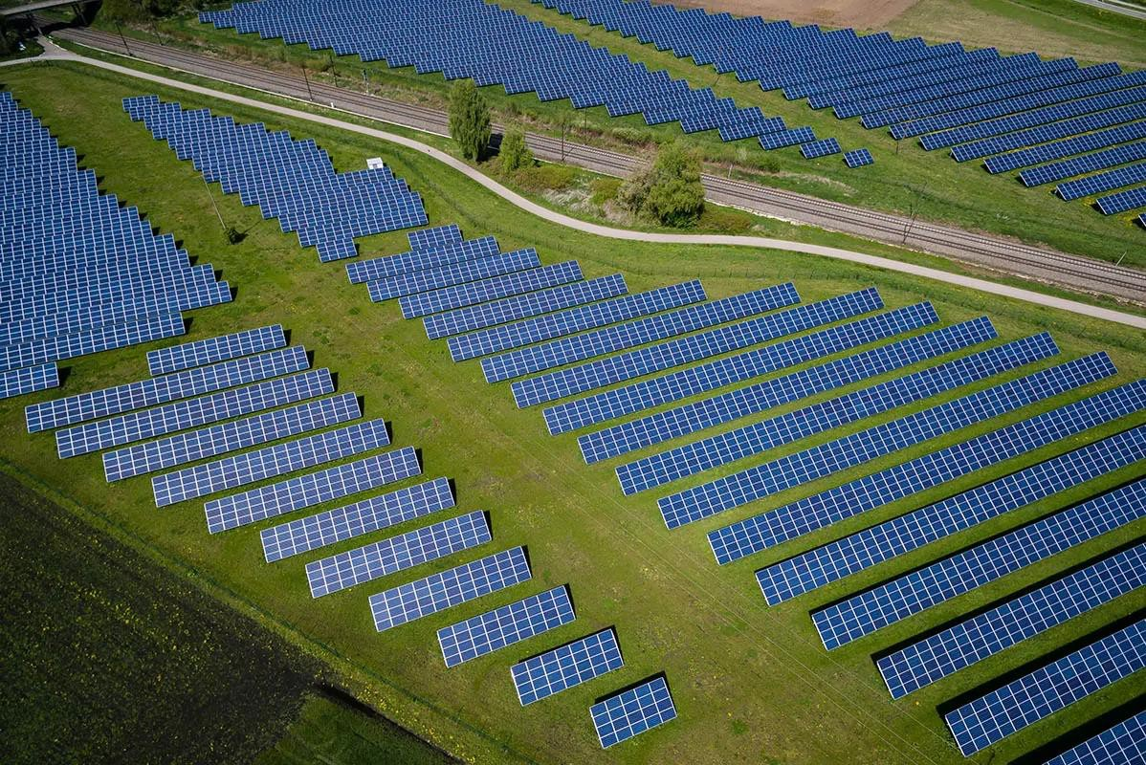
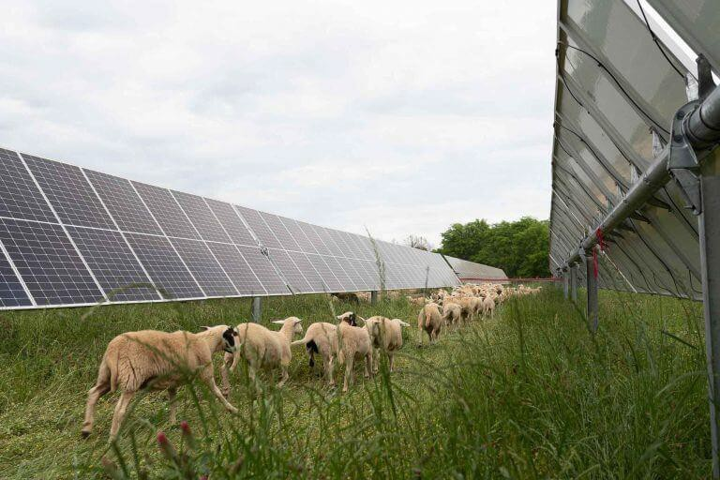
CONCEPT VS. REALITY
This is the side you see on the news.

Slide 42
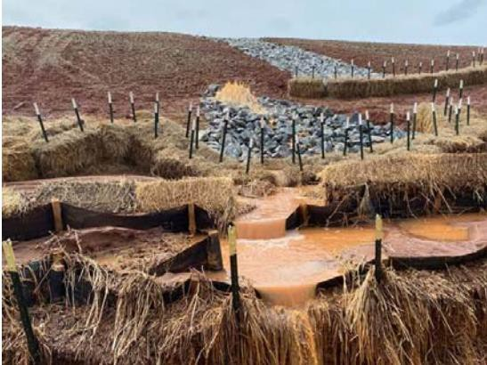
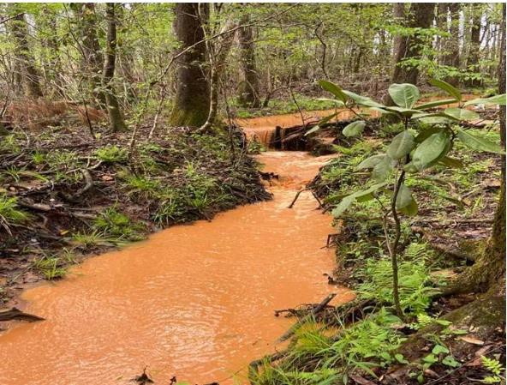
CONCEPT VS. REALITY
This is what you don’t see.

Slide 43
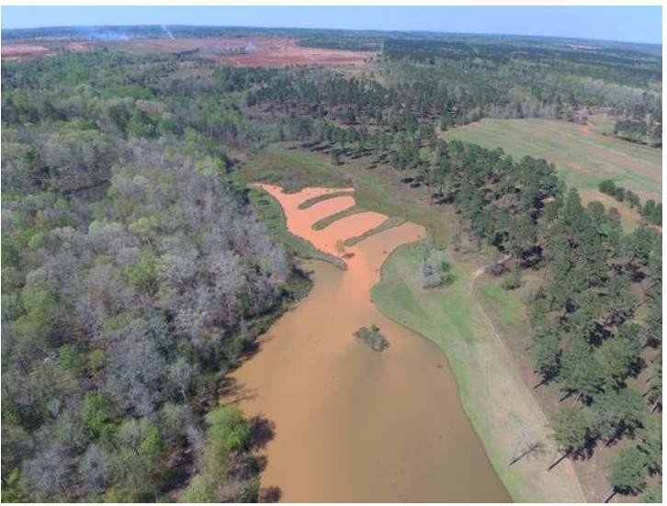
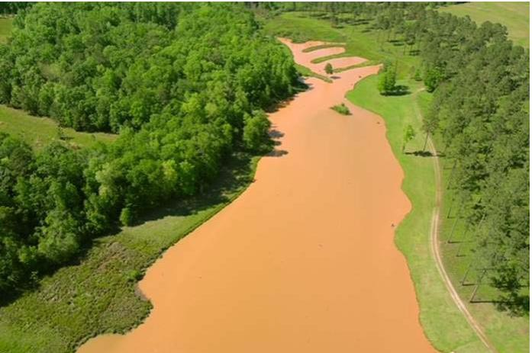
CHALLENGES WITH SOLAR PANEL INSTALLATION
This site was awarded 135 million dollars in a Federal Clean Water Act lawsuit.

Slide 44
WHAT EPD HAS DONE TO ADDRESS SOME OF THESE CHALLENGES
Specific Design Components:
Disturbance should be segmented using naturally existing land characteristics or drainage basins. In most cases, no more than 400 acres should be disturbed at any one time.
The following three (3) additional BMPs must be incorporated:
Increase all temporary sediment basins and retrofitted stormwater management basins to provide sediment storage of at least 3600 cubic feet (134 cubic yards) per acre drained.
Conduct inspections and prepare a seven (7) day letter during the intermediate grading and drainage BMP phase and during the final BMP phase of the project by the design professional who prepared the Plan in accordance with Part IV.A.5. of the permit. (Note: This needs to be done for each segment of the Site.)
Install Post Construction BMPs (e.g., runoff reduction BMPs) which remove 80% TSS as outlined in the Georgia Stormwater Management Manual known as the Blue Book or an equivalent or more stringent design manual.
One more BMP must be incorporated from a list of 6 possible additional BMPs.

Slide 45
WHAT EPD HAS DONE TO ADDRESS SOME OF THESE CHALLENGES
Specific Design Components:
The Construction Schedule must be developed to ensure the completion of all land disturbance (including trenching, foundation installation, and superstructure installation) and the establishment of at minimum, temporary stabilization on all disturbed acreage before the installation of solar panels can be completed.
The schedule must include the Site’s intent to:
Establish, at minimum, temporary stabilization for the entire project before the installation of panels, OR
Establish, at minimum, temporary stabilization on each segment of the site before the installation of panels and the commencement of the next segment.
For solar farm projects, solar panels are to be considered impervious areas when determining the calculations and the post-construction impervious area shall be calculated as 70% of the square footage of the solar panels.

